Slide 1







Connecting Dots
Your extra is someone’s need.

Slide 2
Group No : 26
A29 Kumawat Mukesh 202100319010027
B71 Prajapati Laxmi 202100319010164
C34 Lil Drashti 202100319010222
PROJECT GUIDE:-PROF. DEEP MAVAWALA FACAIT,BCA.

Slide 3
Index
01
Company Details
06
User Panel Screenshots
02
Introduction
07
NGO Panel Screenshots
03
Project Profile
08
Volunteer Panel Screenshots
04
Admin Panel Screenshots
09
Conclusion
05
Reports
10
Bibliography

Slide 4
01
Company Details

Slide 5
Name : Aarnik Technology
Contact No : 9586248516
Website : aarniktechnology.com
Email ID : info@aarniktechnology.com
Address : K/8, Shree Krishna Centre Above Crossword Library, Mithakali Six Road, Navrangpura , Ahmedabad- 380009.

Slide 6
02
Introduction

Slide 7
Introduction
“Connecting Dots” will provide a facilities that donors can directly connect to the NGOs and donor can donate required donation to them.
With the help of this website user can search for NGO area wise.
User can book various events in NGO and NGO will upload related videos on website.

Slide 8
03
Project Profile

Slide 9











System Requirement
Software Used :
Server :-
Front End :-
Back End :-
Open Source Library :-
Scripting Language :-
Visual Studio
draw.io

Slide 10

Existing System
At that time, We Don’t have any system. We have worked manually.
Users needs to search NGO from google.
Users has to visit NGO manually to get all information about the NGO.

Slide 11




Proposed System
Users can easily find various NGOs by location and get all the information about NGOs from the website.
Volunteer will collect the donation item from user and deliver to the NGO.
NGO can share their requirement on website , User can view and donate according to the NGOs requirements.
System will also provide payment gateway to pay donation online.

Slide 12
04
Admin Panel Screenshots

Slide 13
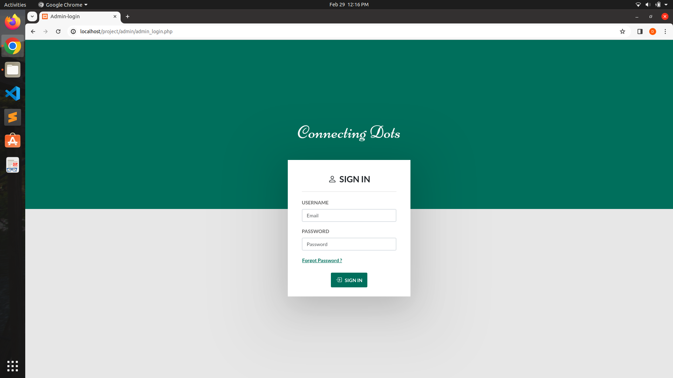
Admin Login:

Slide 14
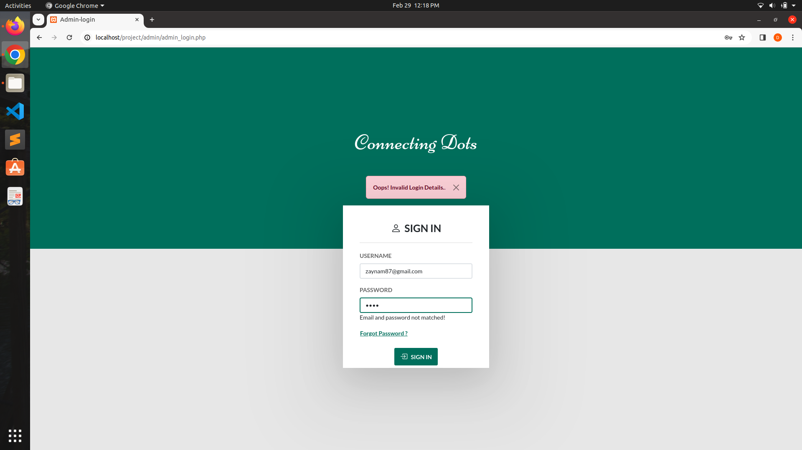
Admin Invalid Login:

Slide 15
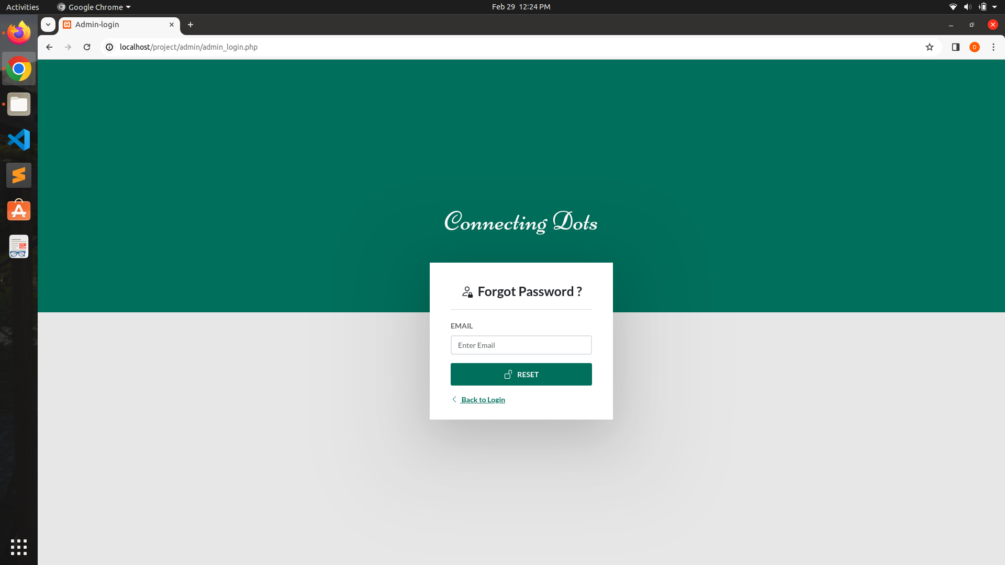
Admin Forgot Password Form:

Slide 16
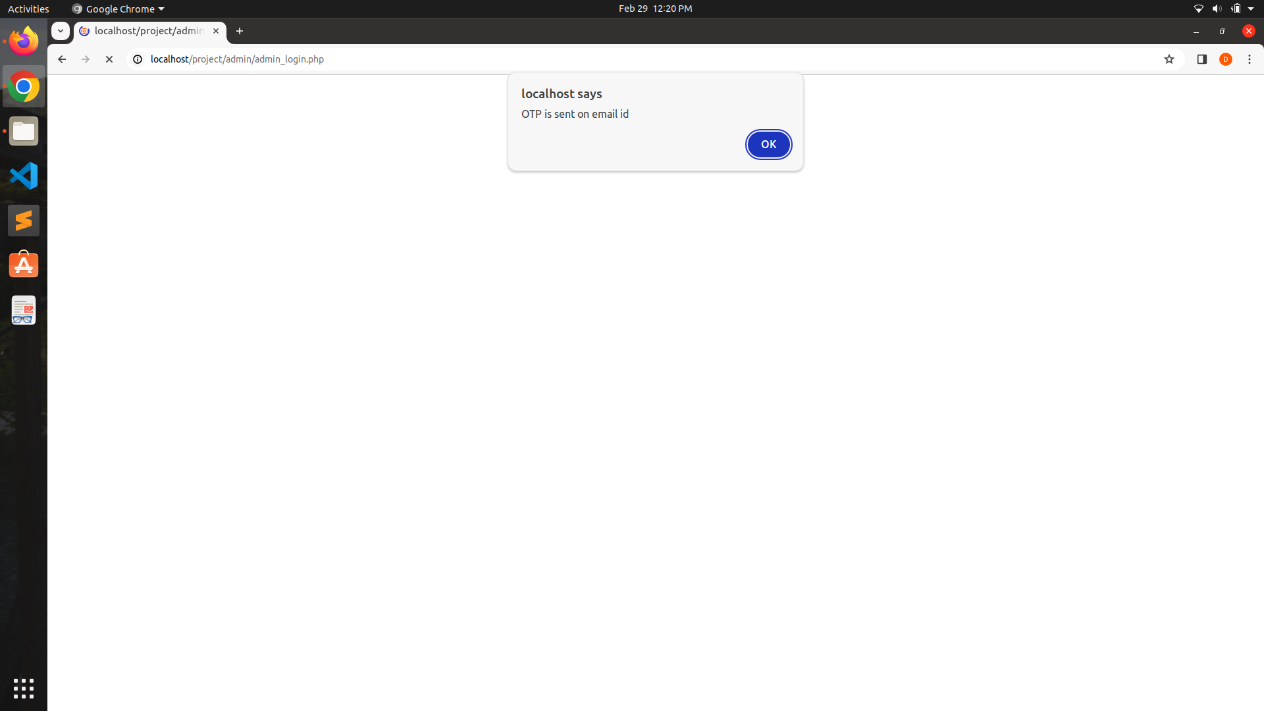
OTP sent on Email:

Slide 17
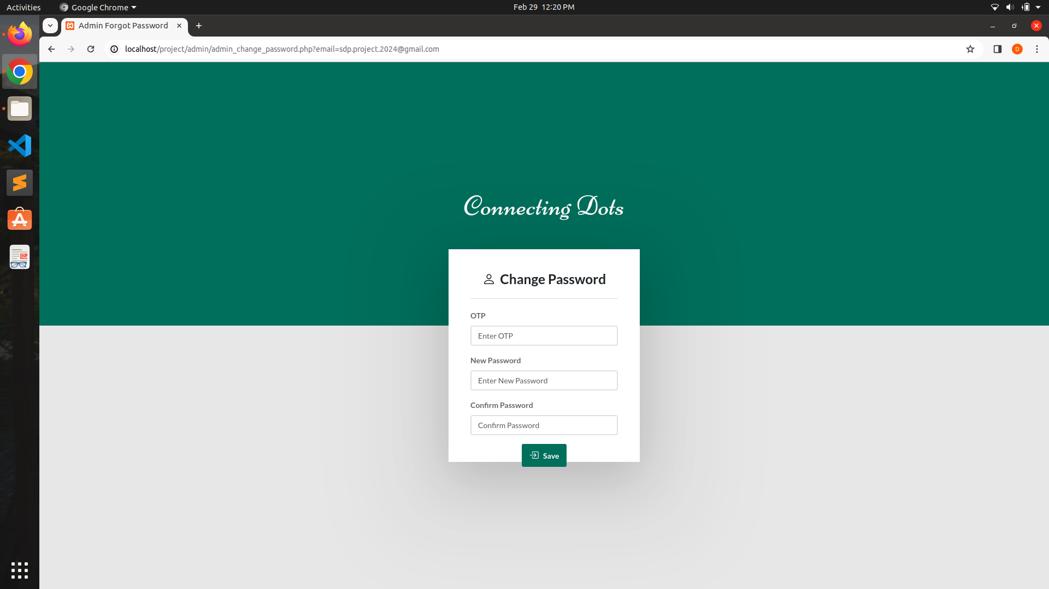
Admin Change Password Form:

Slide 18

OTP Not Match:

Slide 19

Password Changed:

Slide 20
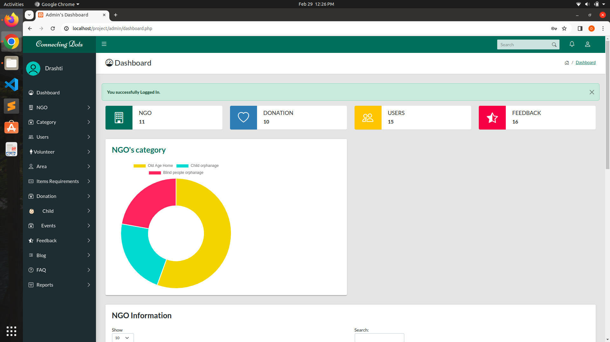
Admin Dashboard:

Slide 21
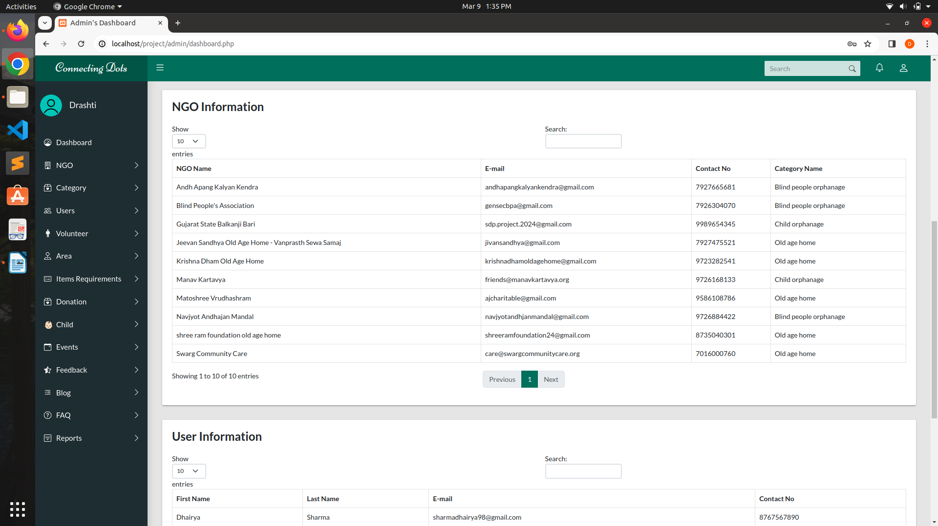
Admin Dashboard:

Slide 22
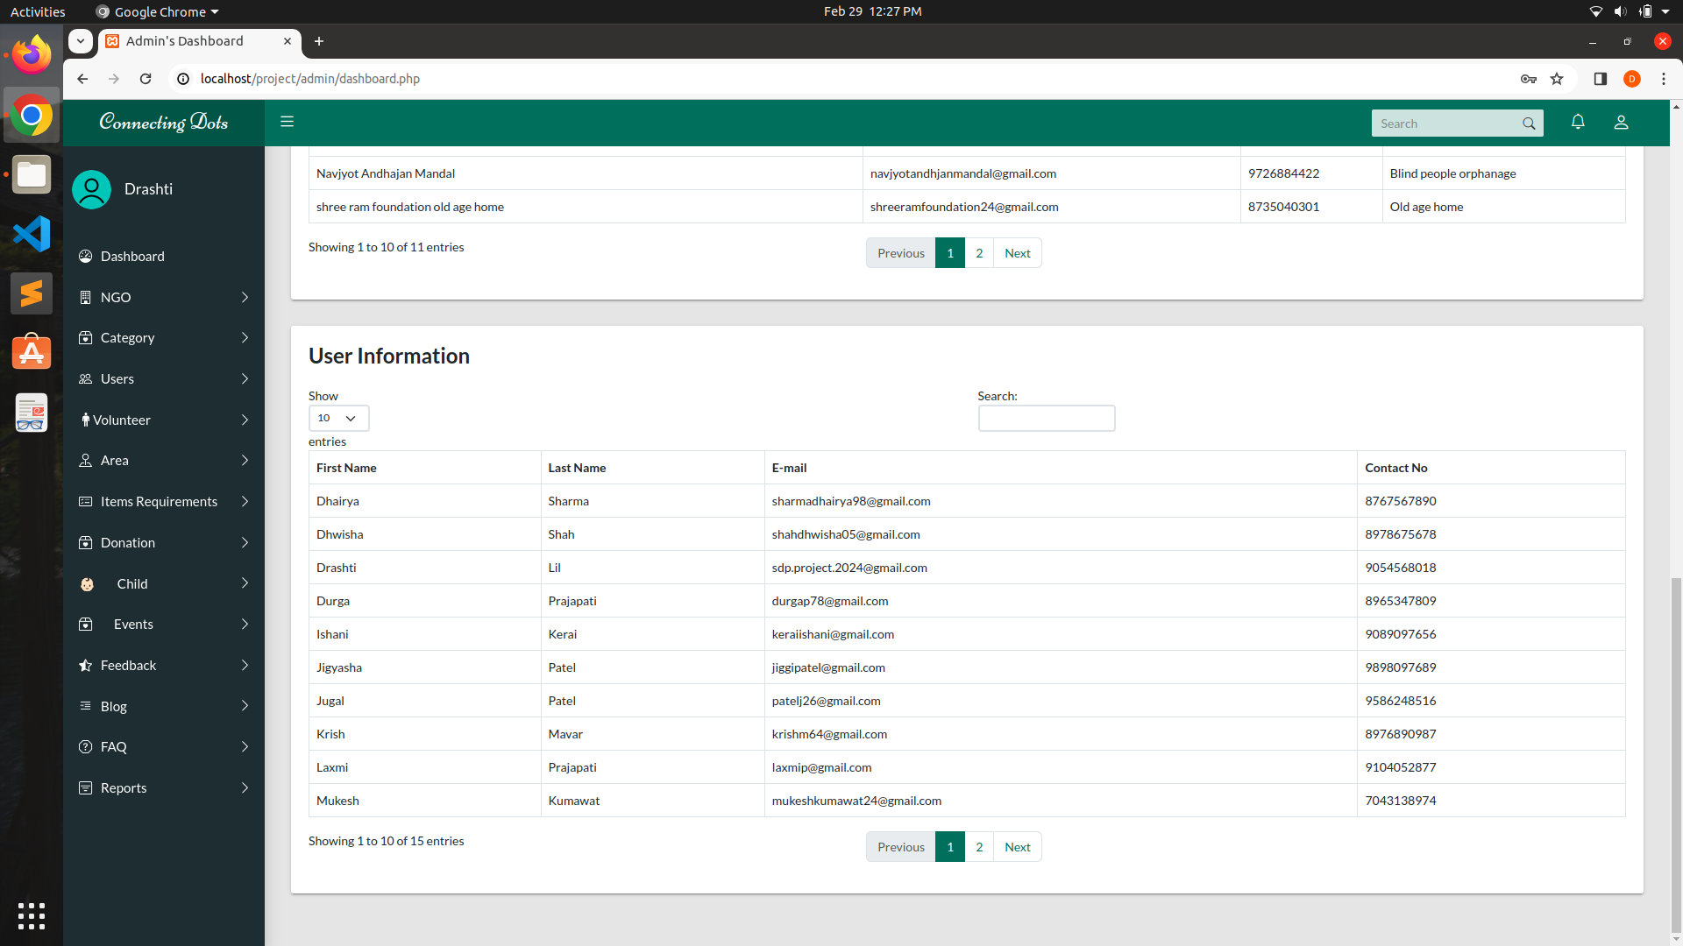
Admin Dashboard:

Slide 23
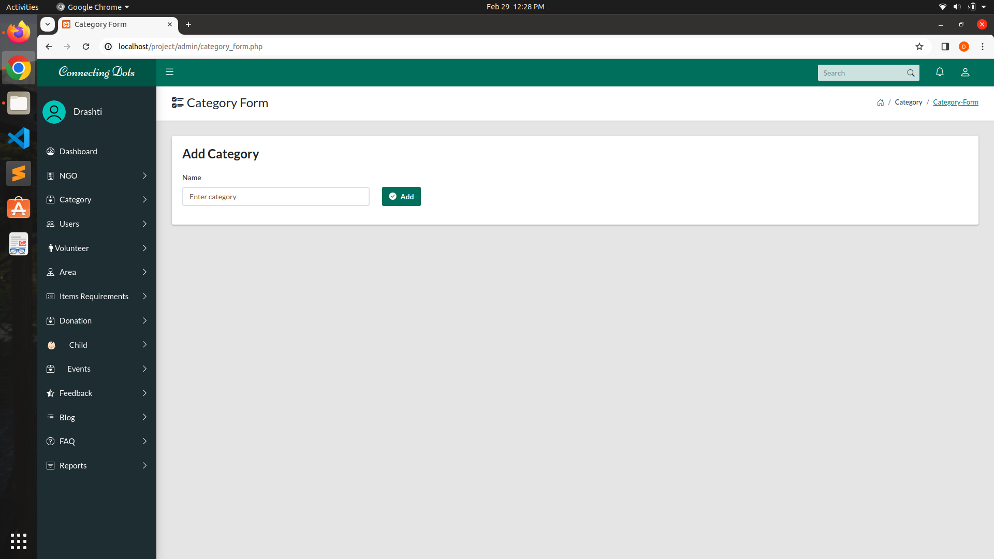
Category Form:

Slide 24

Category added to the database:

Slide 25
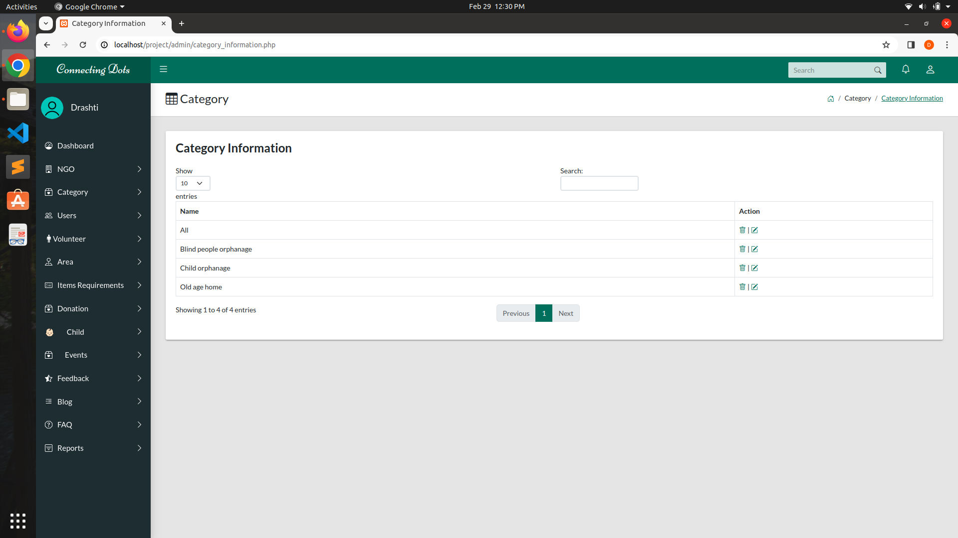
Category Information :

Slide 26
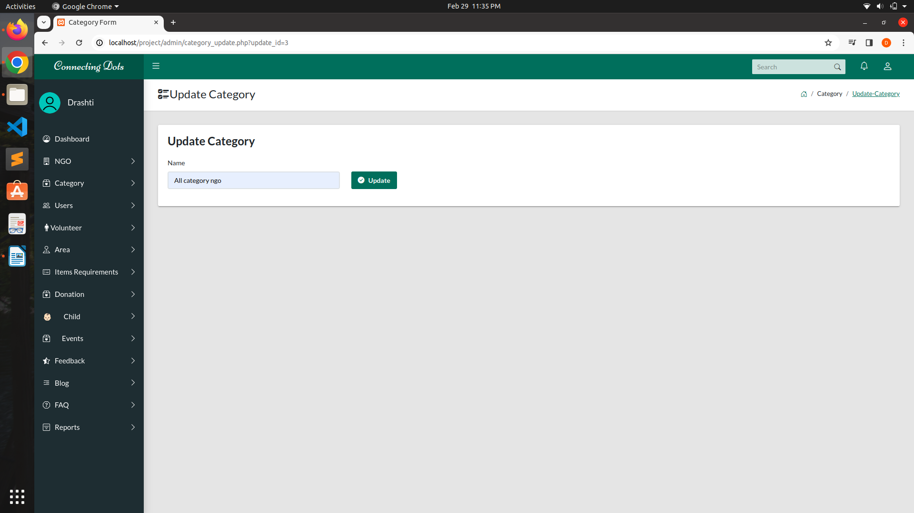
Update Category Information:

Slide 27

Category Updated:

Slide 28
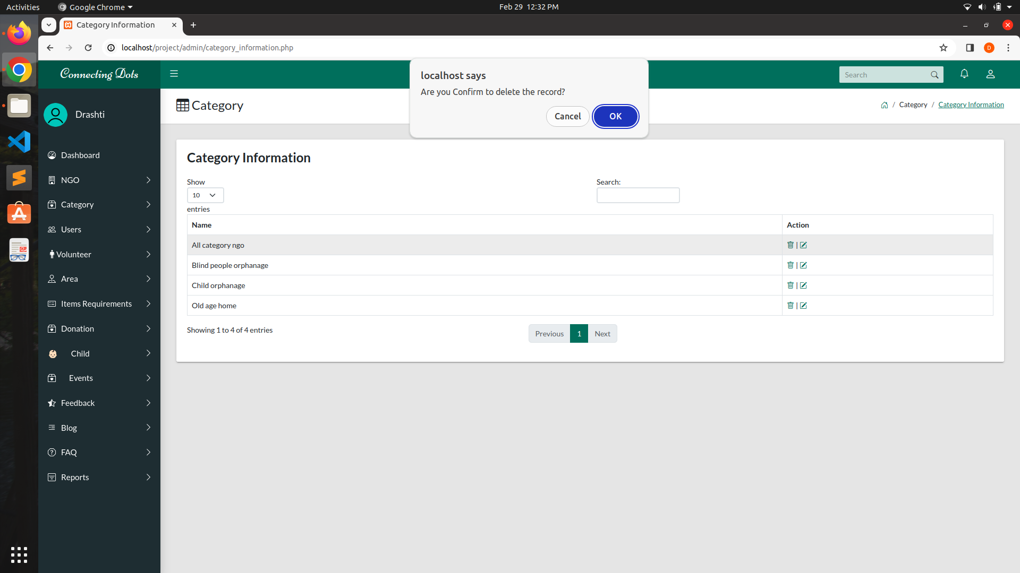
Delete Category:

Slide 29
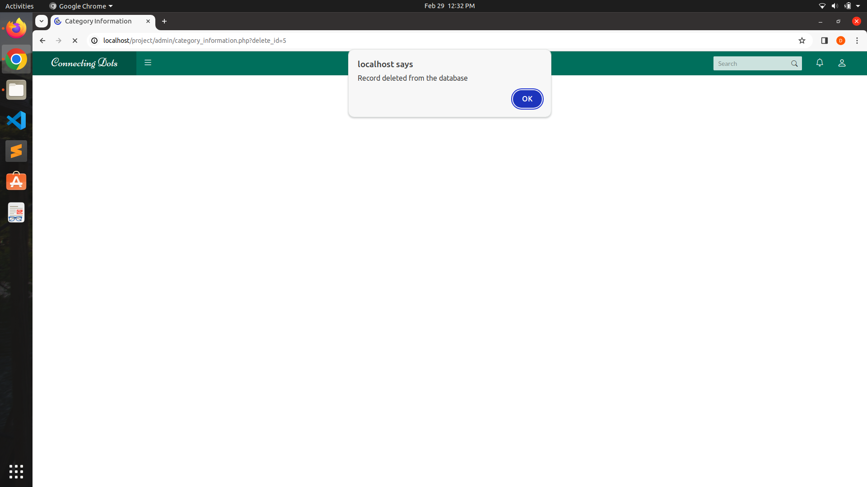
Category Deleted:

Slide 30
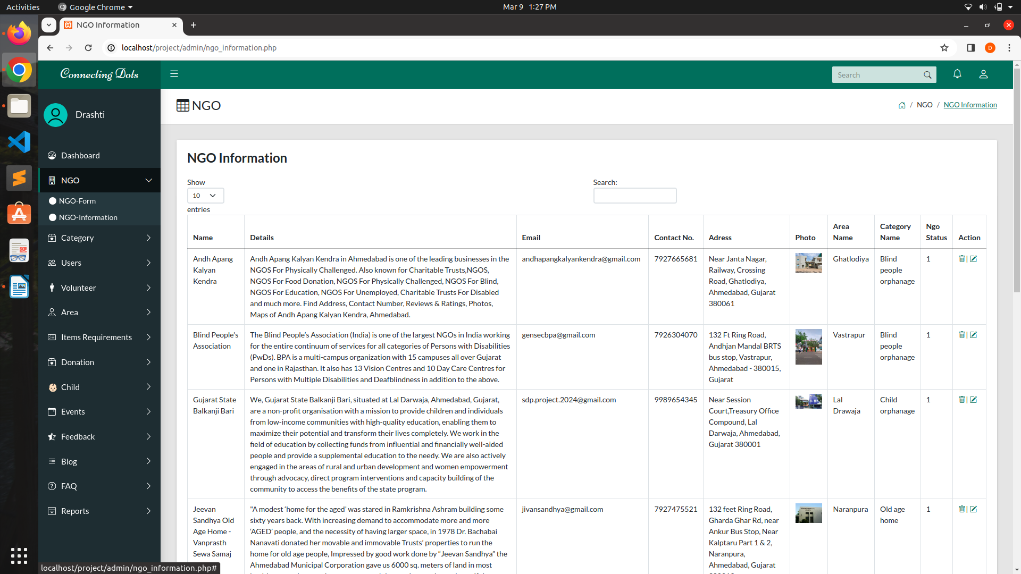
NGO Information :

Slide 31
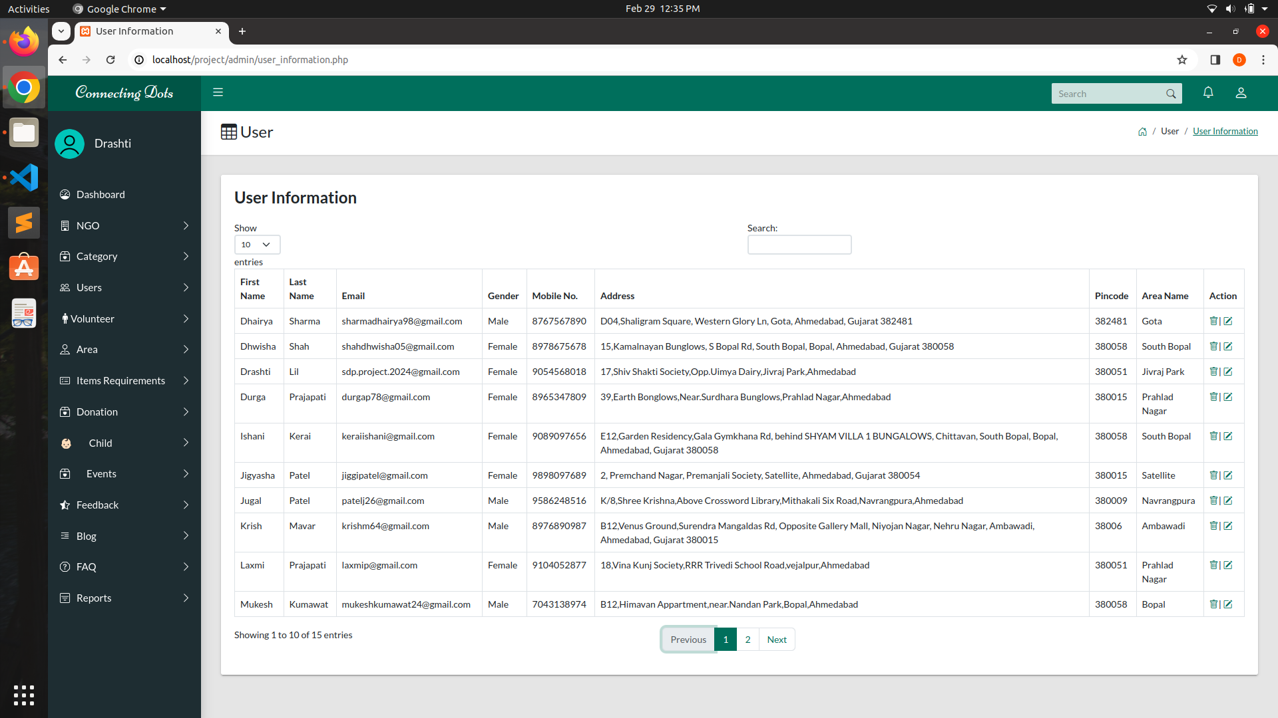
User Information :

Slide 32
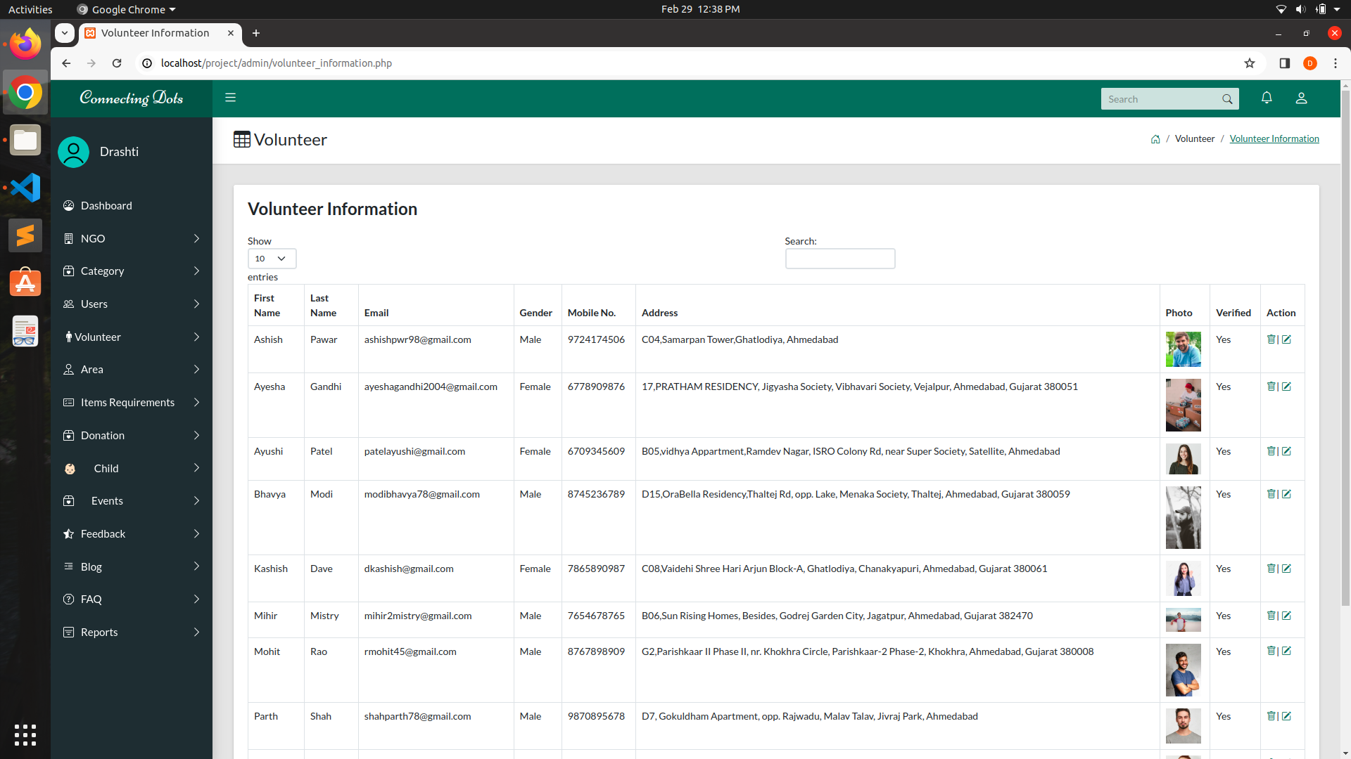
Volunteer Information :

Slide 33
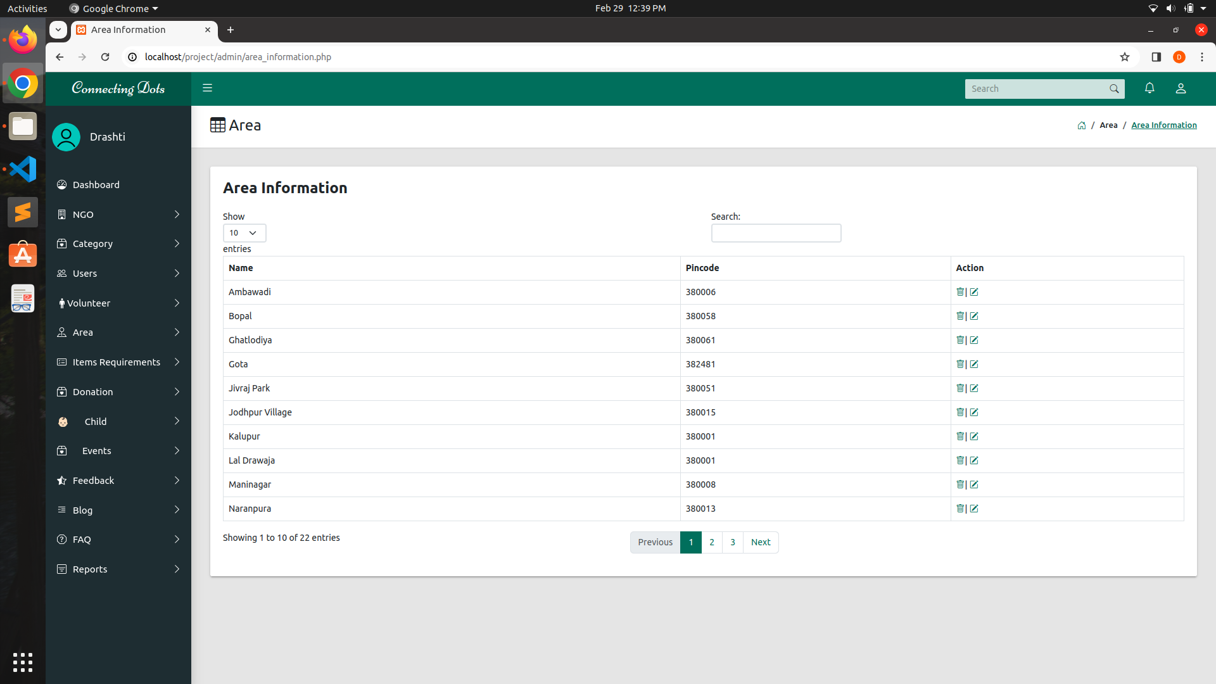
Area Information :

Slide 34
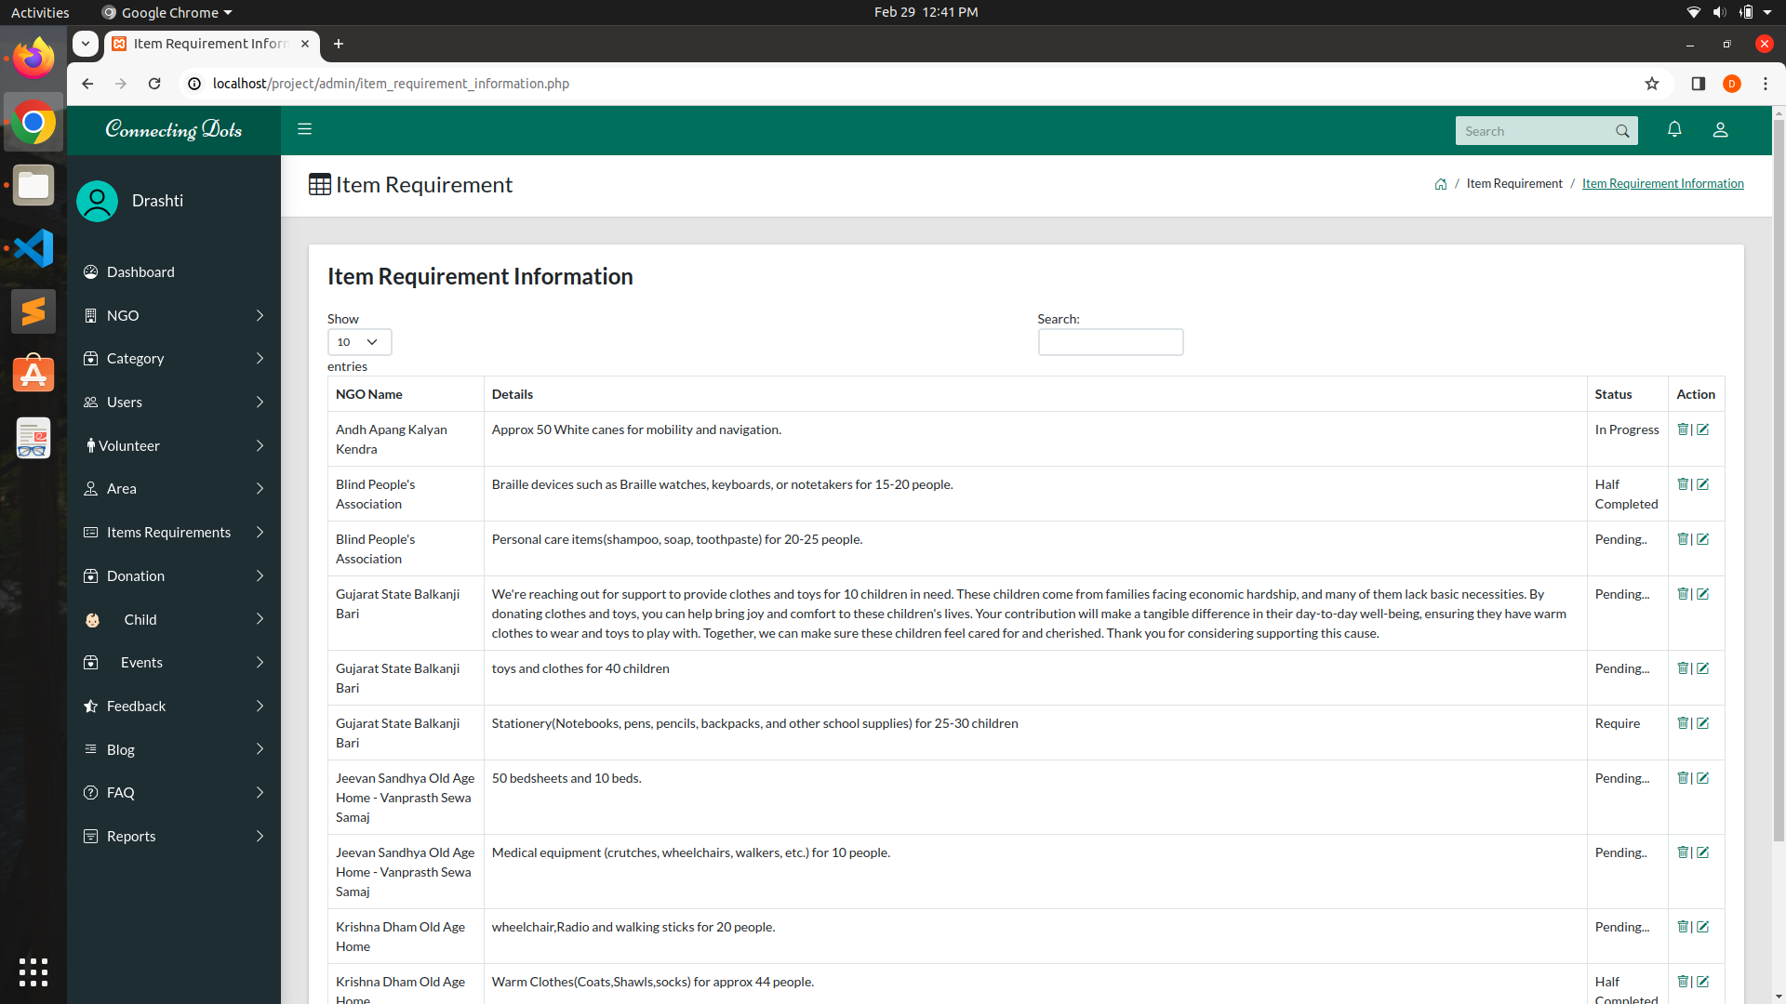
Item Requirement Information :

Slide 35
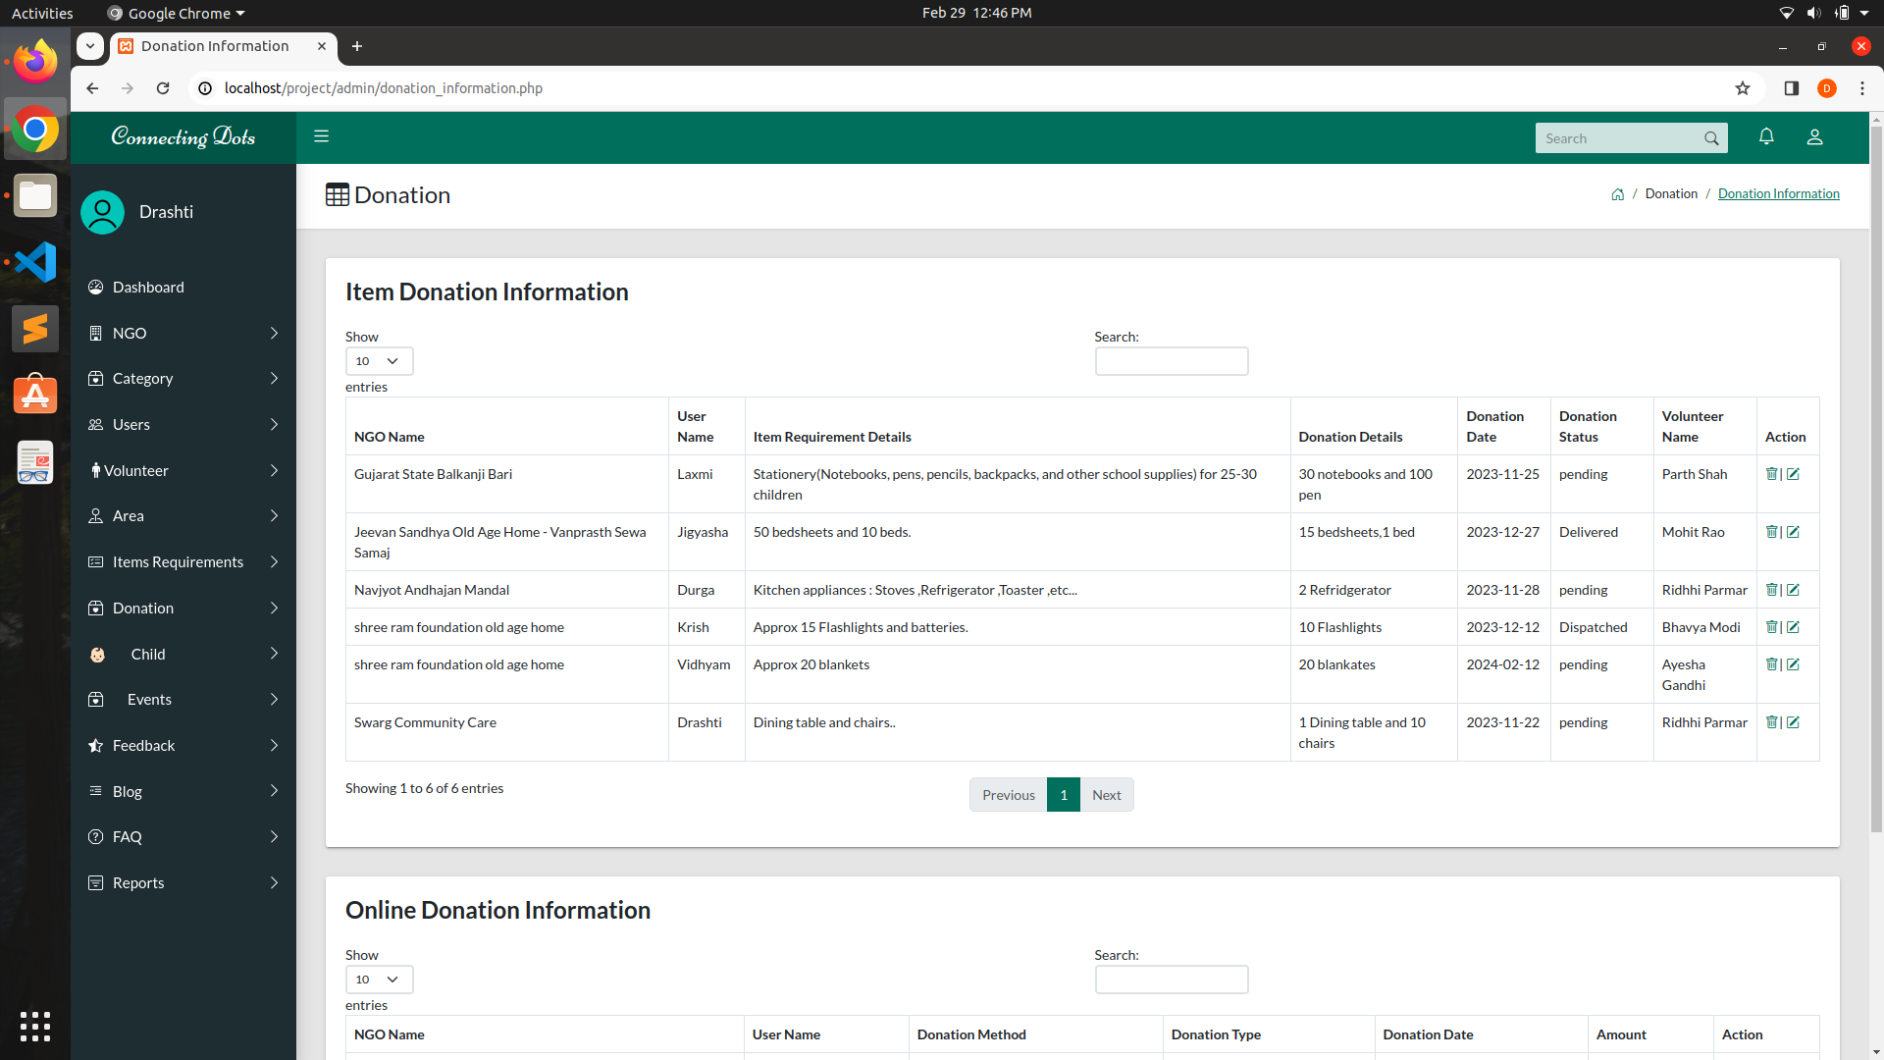
Donation Information :

Slide 36
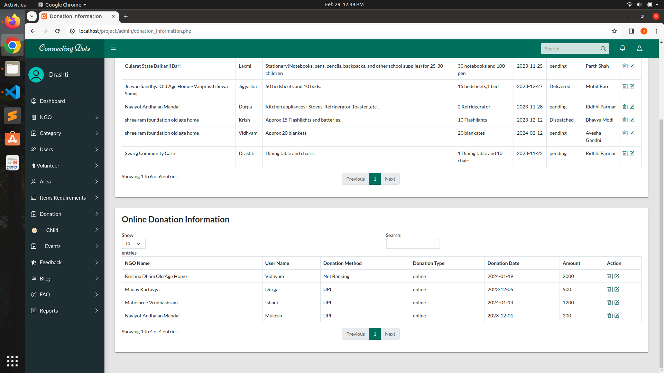
Donation Information :

Slide 37
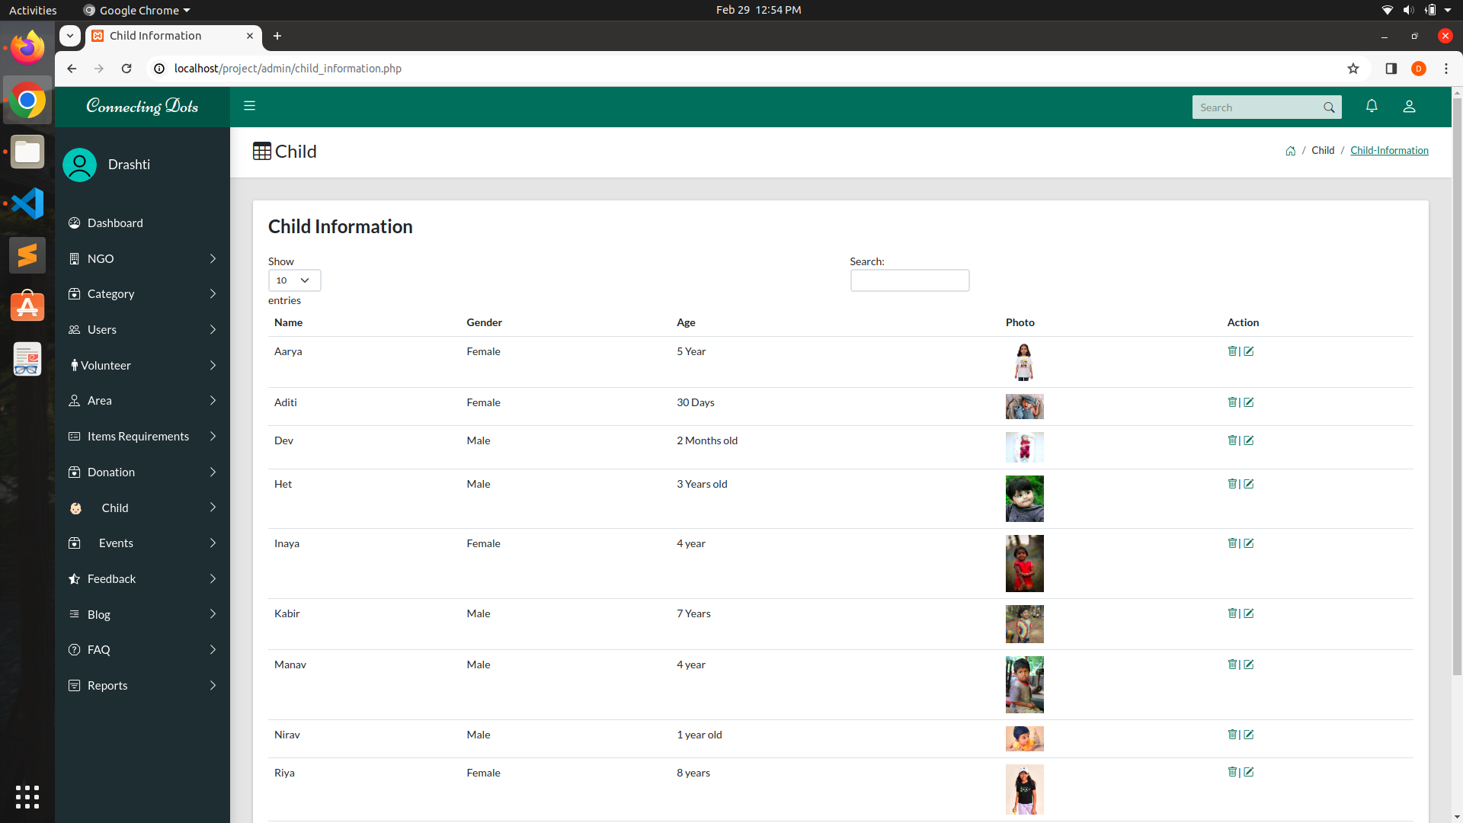
Child Information :

Slide 38
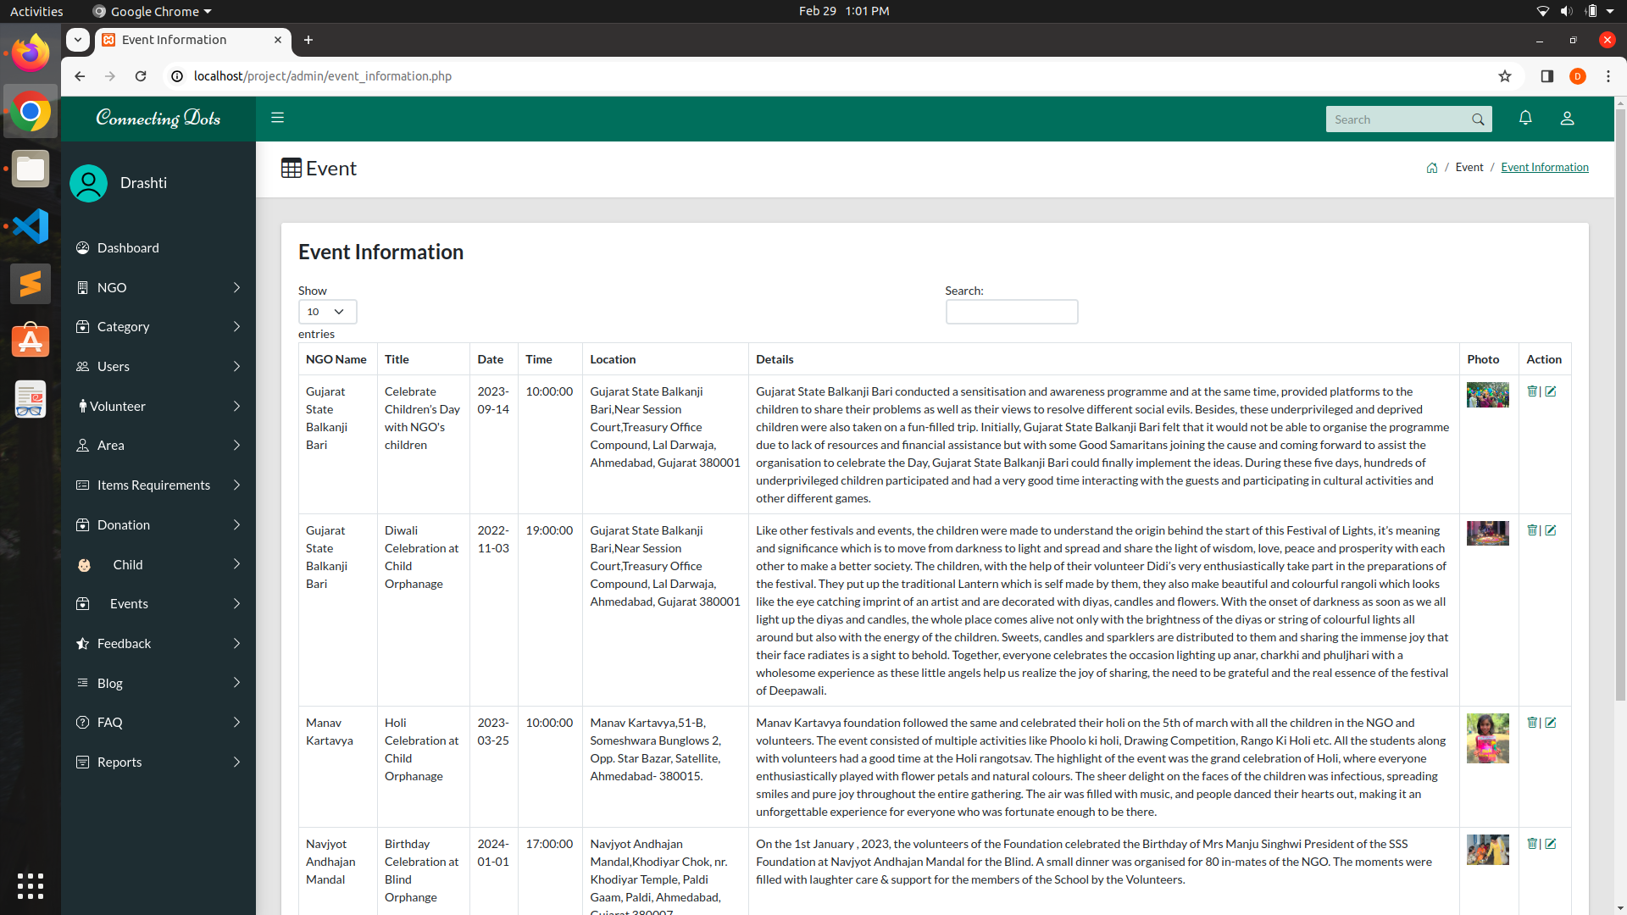
Event Information :

Slide 39

Feedback Information :

Slide 40
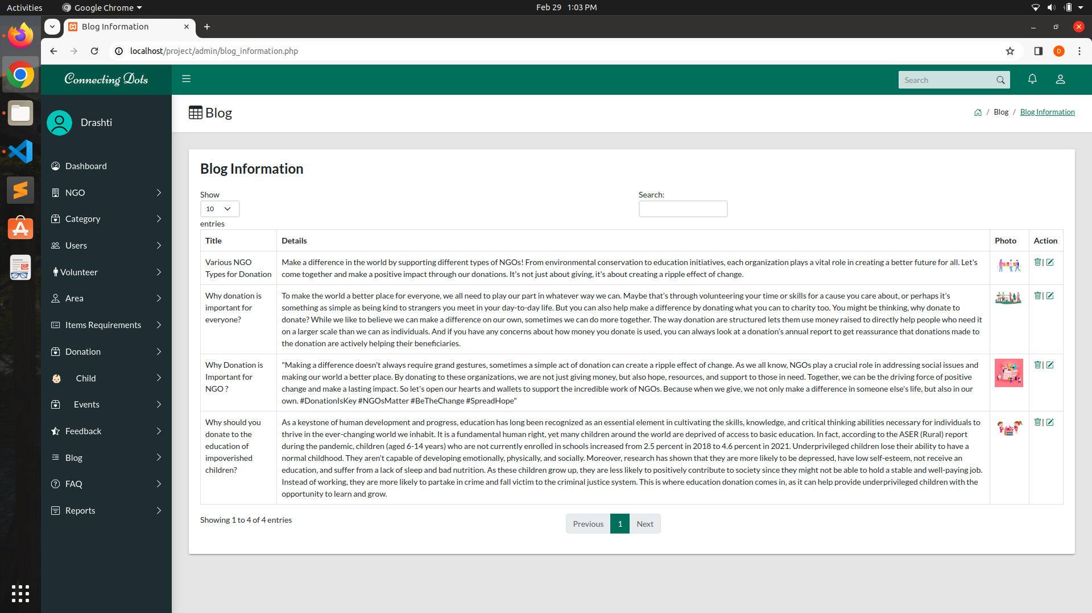
Blog Information :

Slide 41
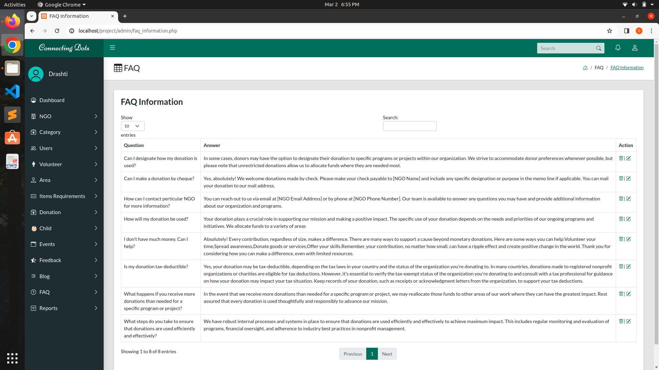
FAQ Information :

Slide 42
05
Reports

Slide 43
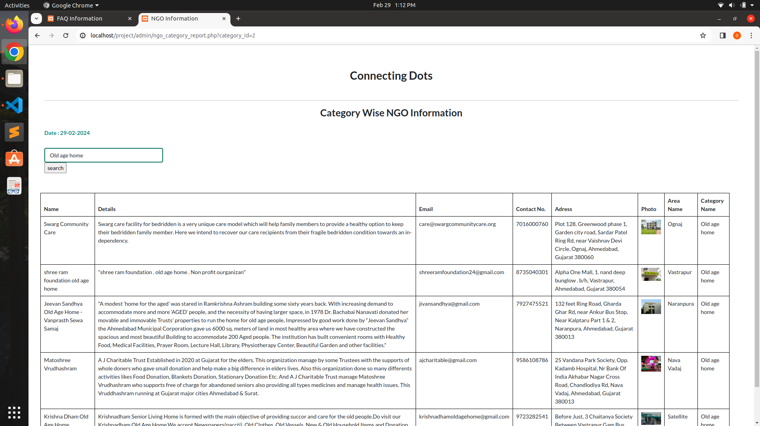

Slide 44
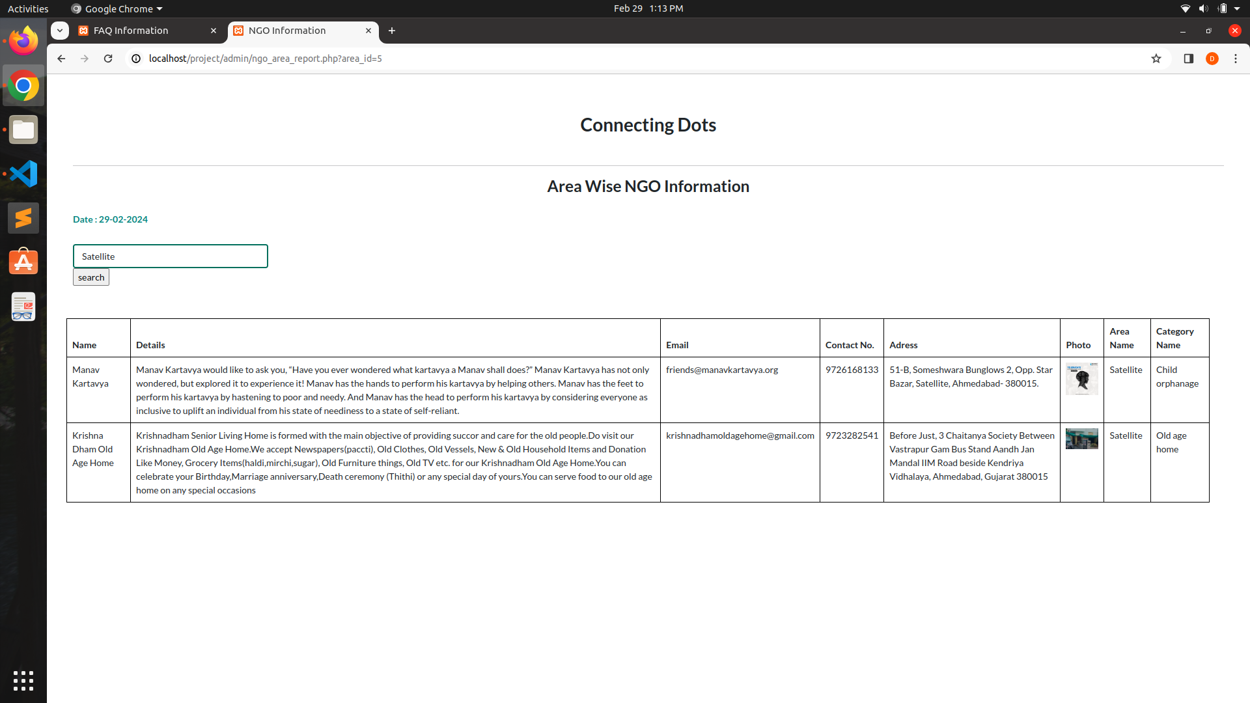

Slide 45
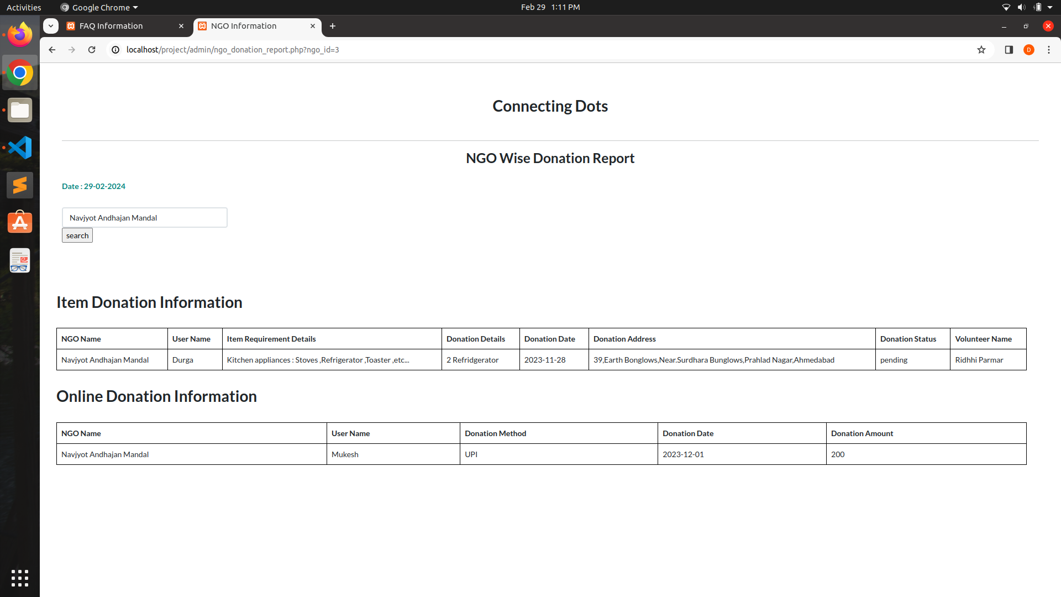

Slide 46
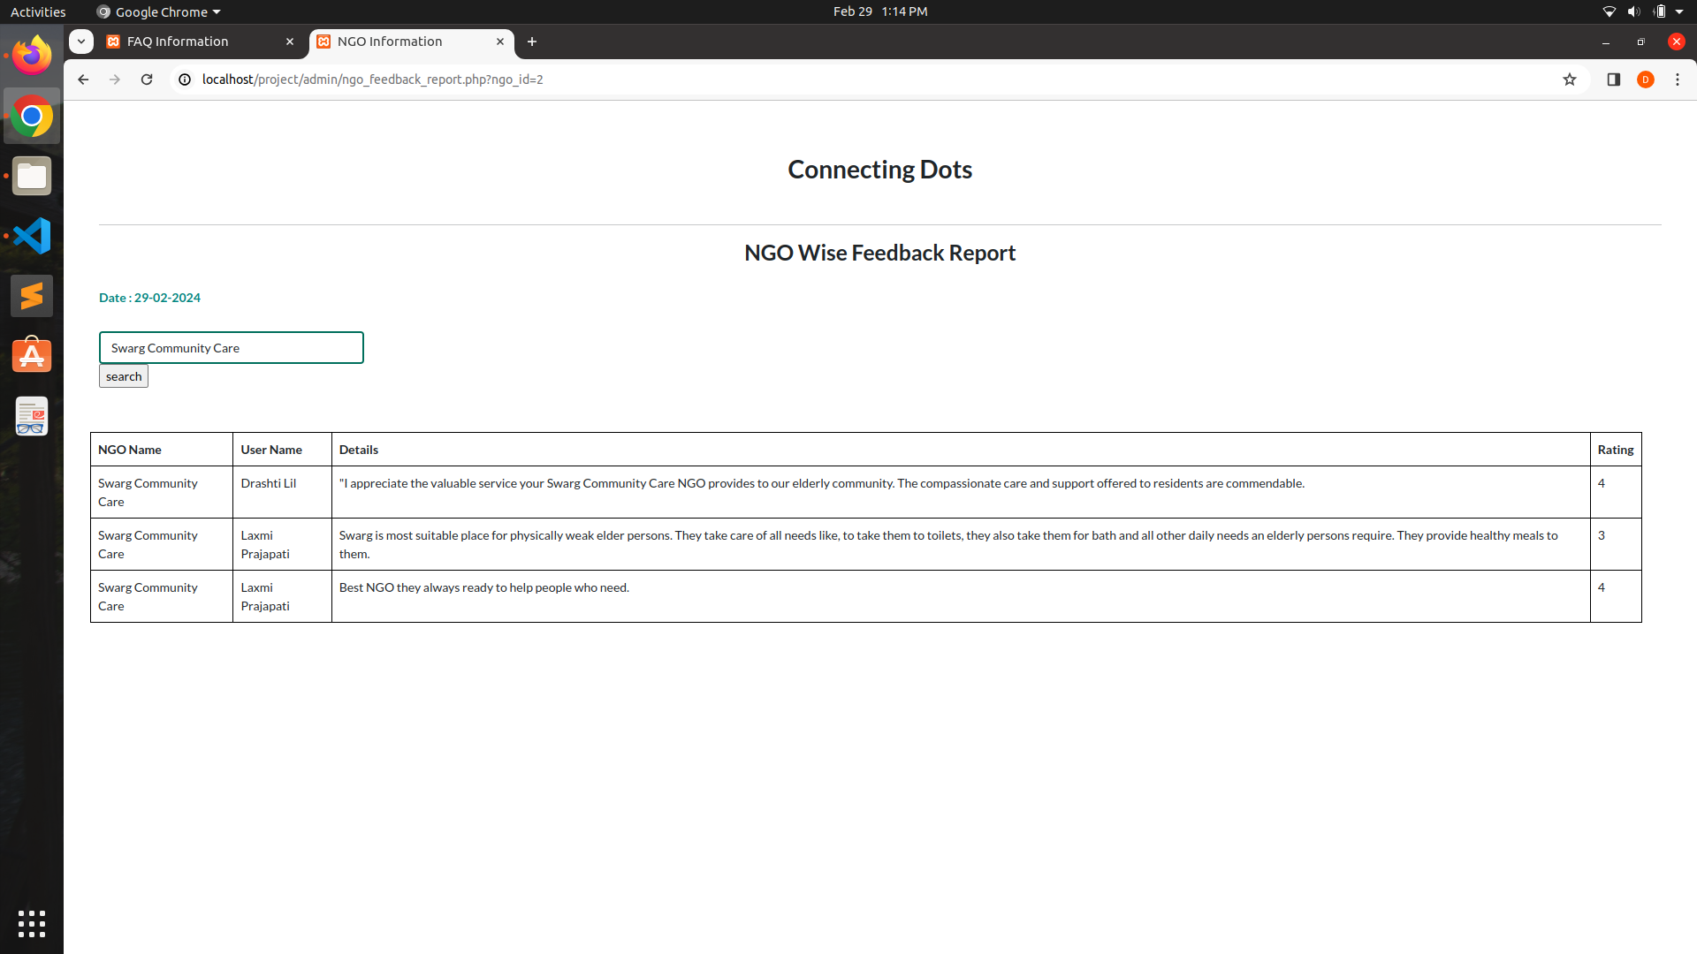

Slide 47
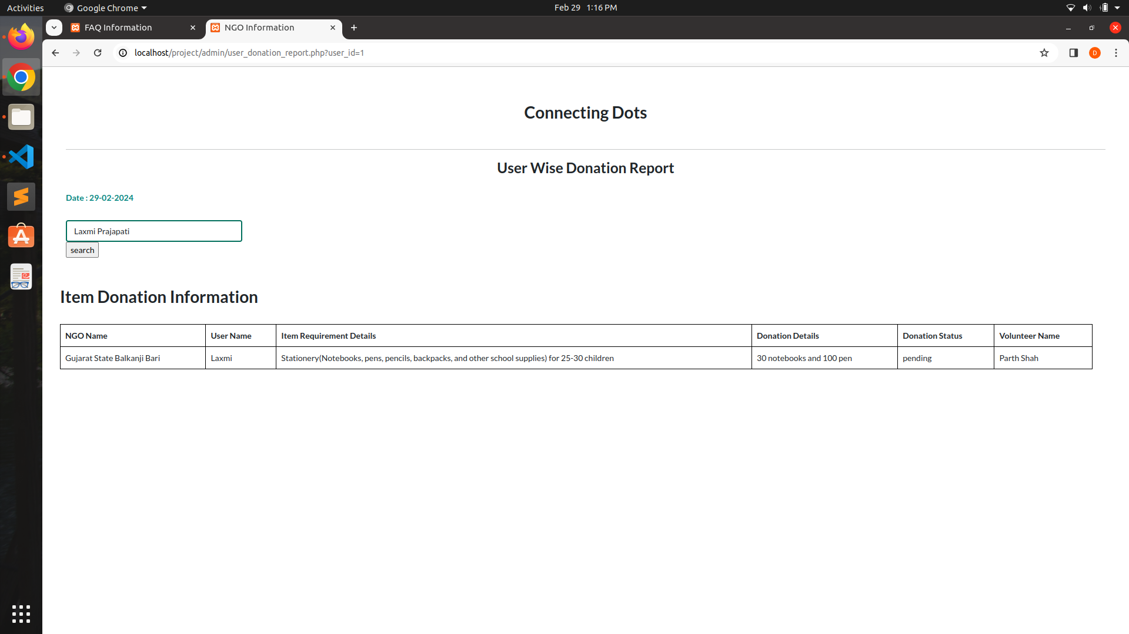

Slide 48
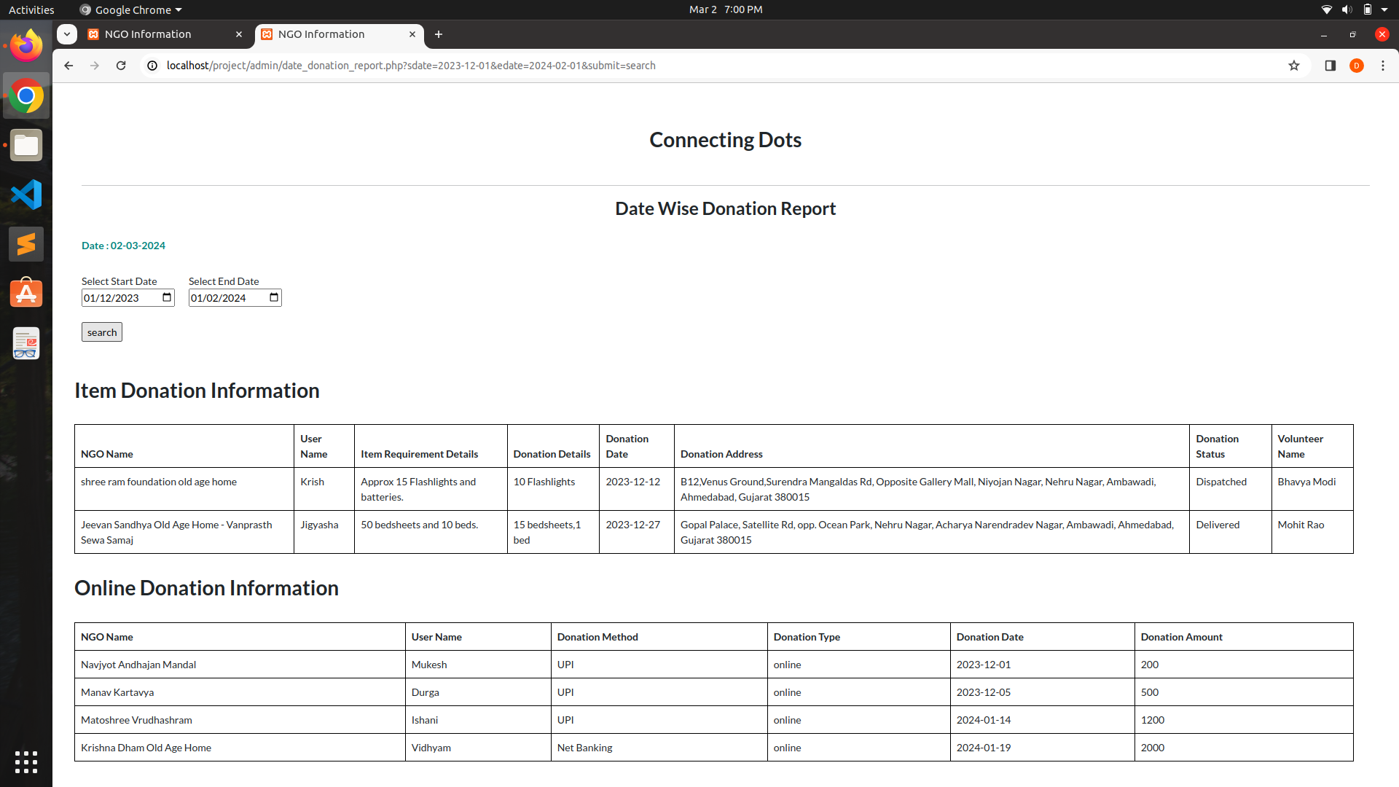

Slide 49
06
User Panel Screenshots

Slide 50
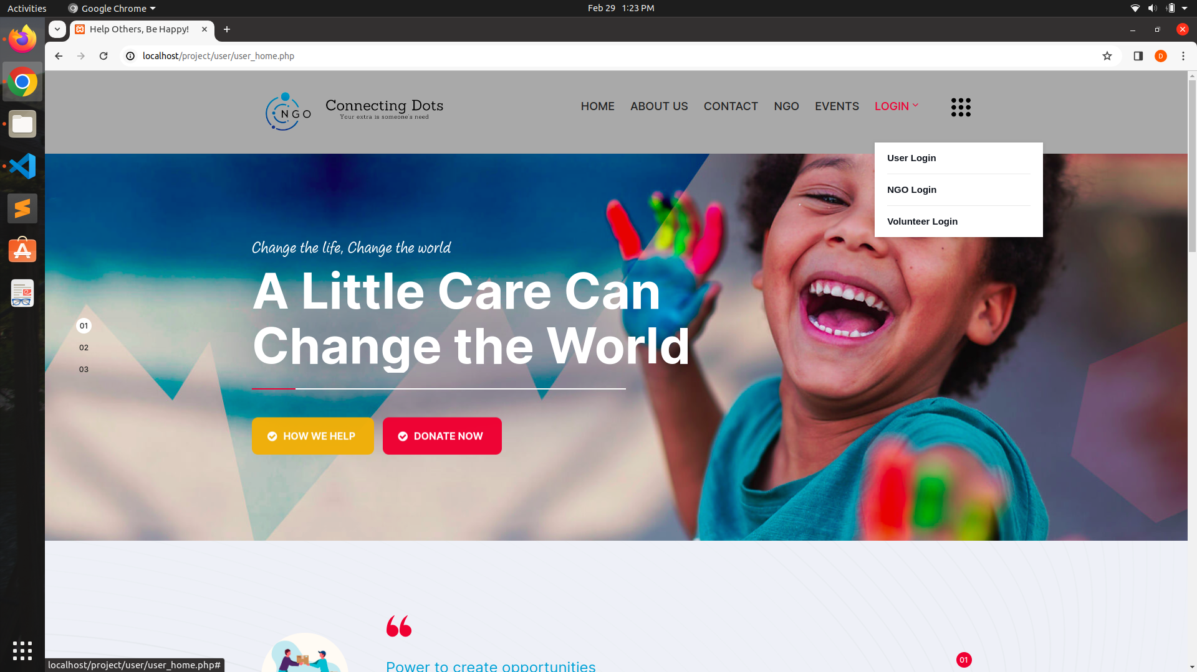
User Home Page Without Login:

Slide 51
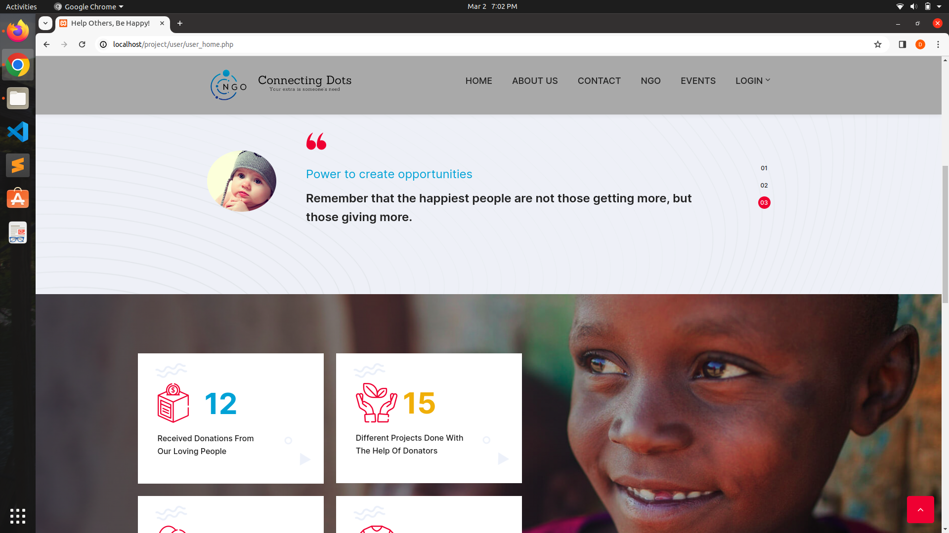
User Home Page Without Login:

Slide 52
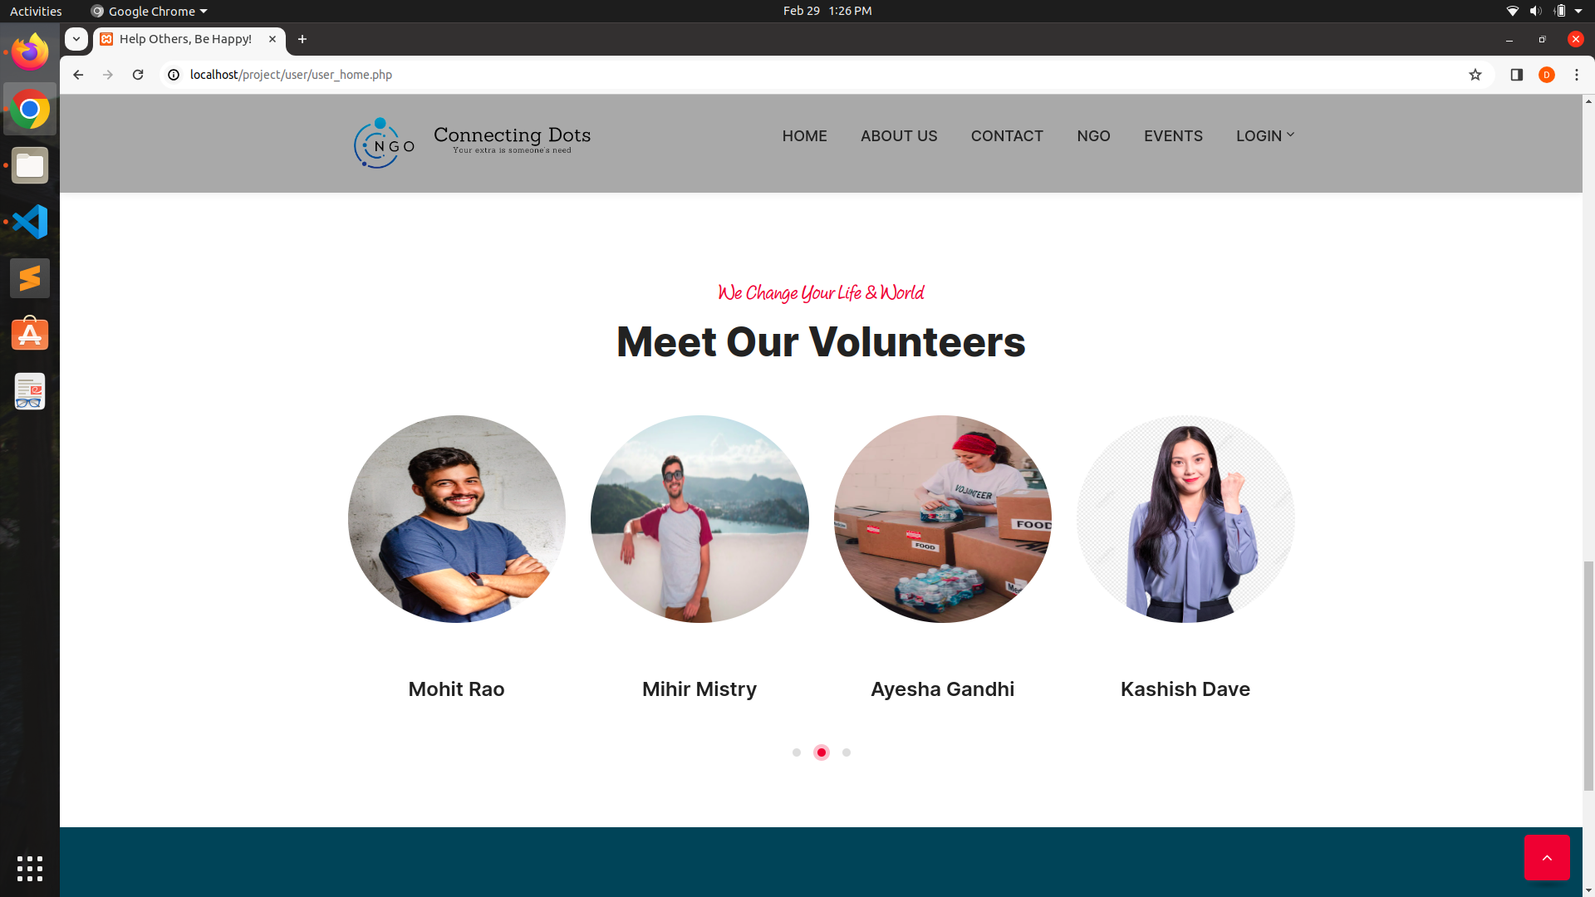
User Home Page Without Login:

Slide 53
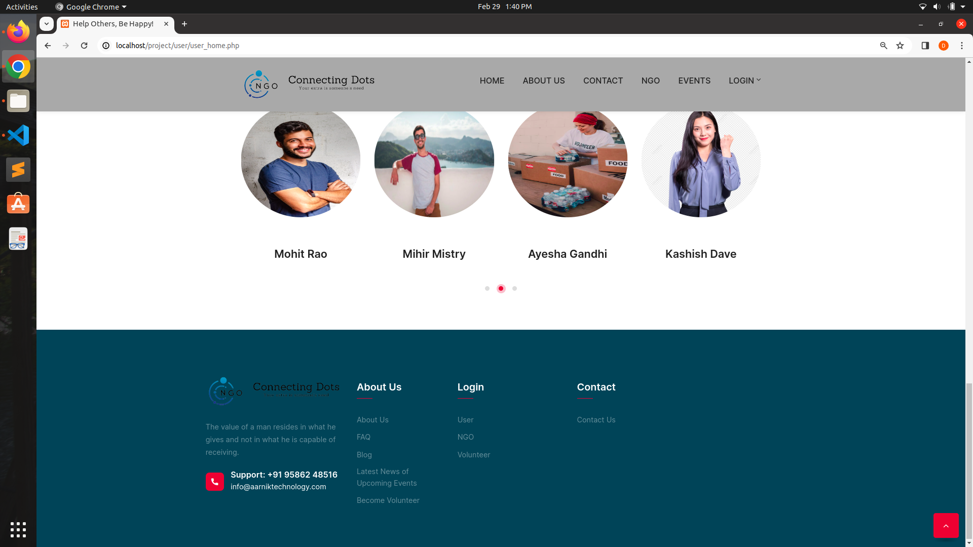
User Home Page Without Login:

Slide 54
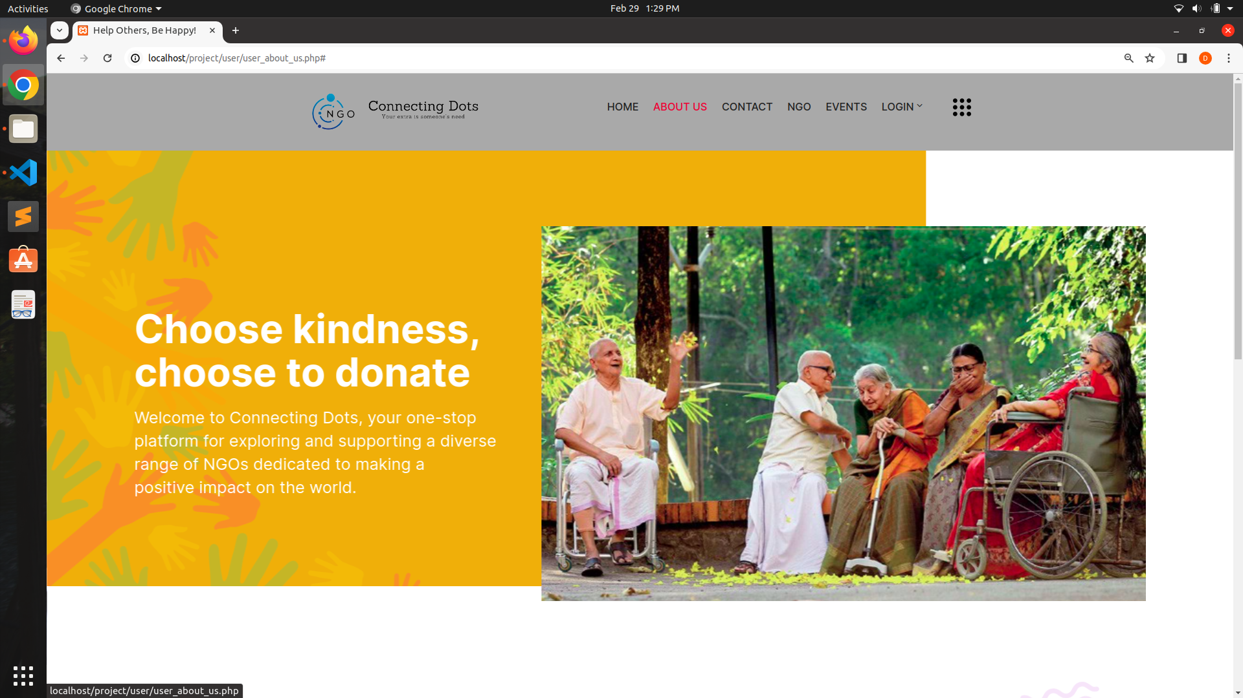
User About Us:

Slide 55
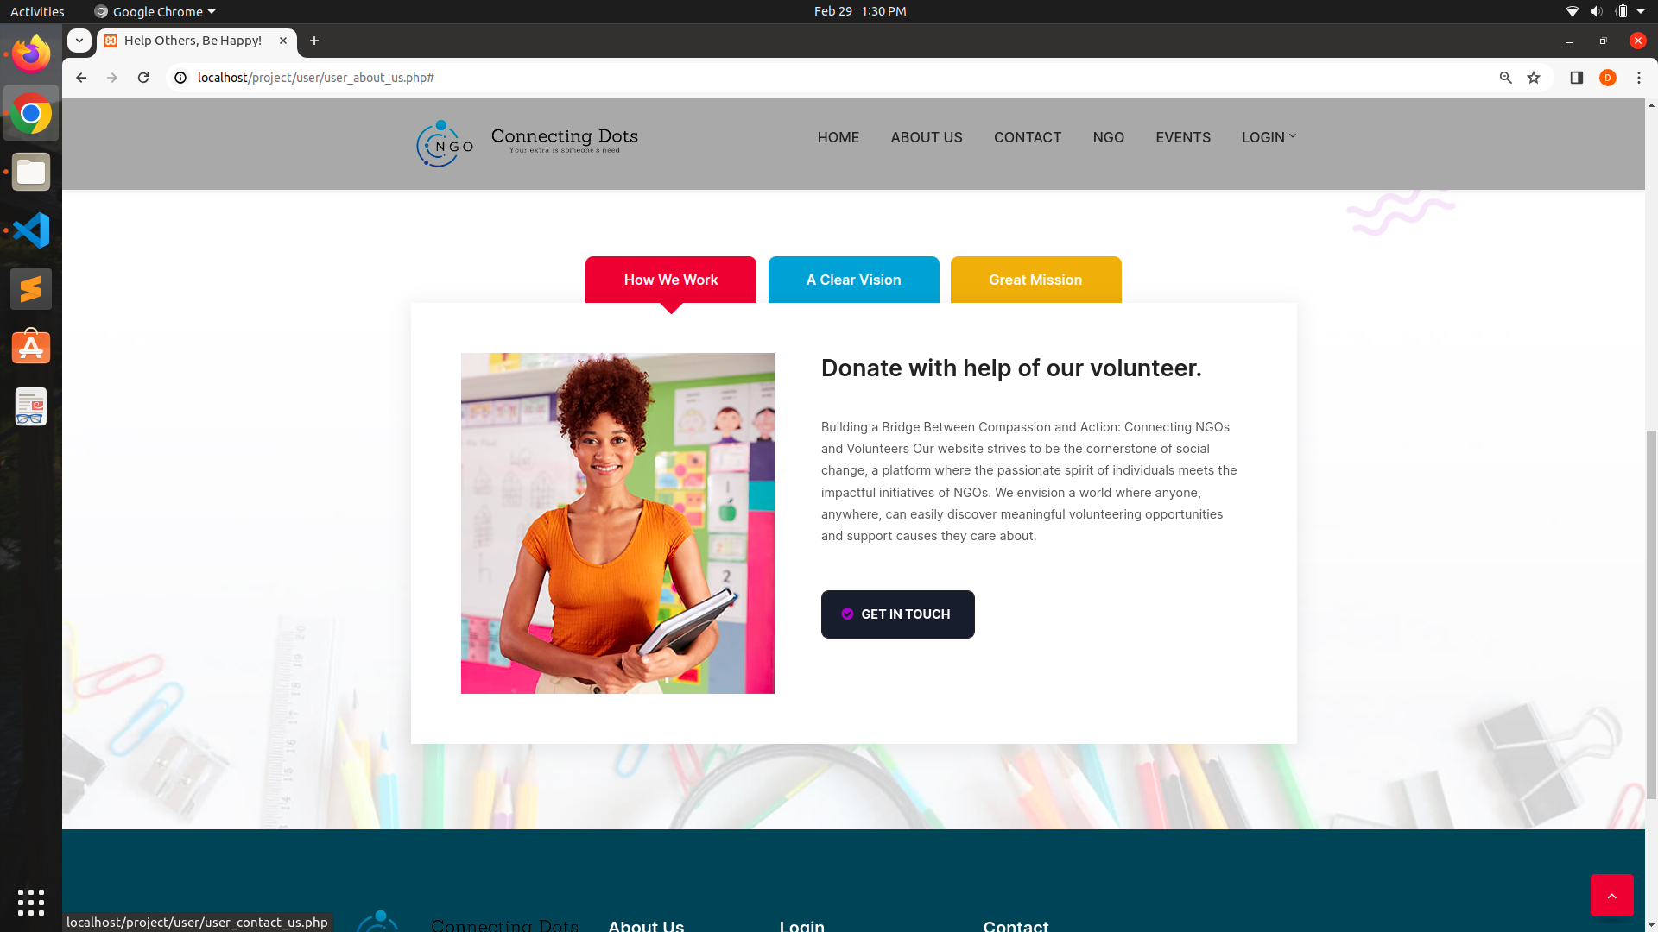
User About Us:

Slide 56
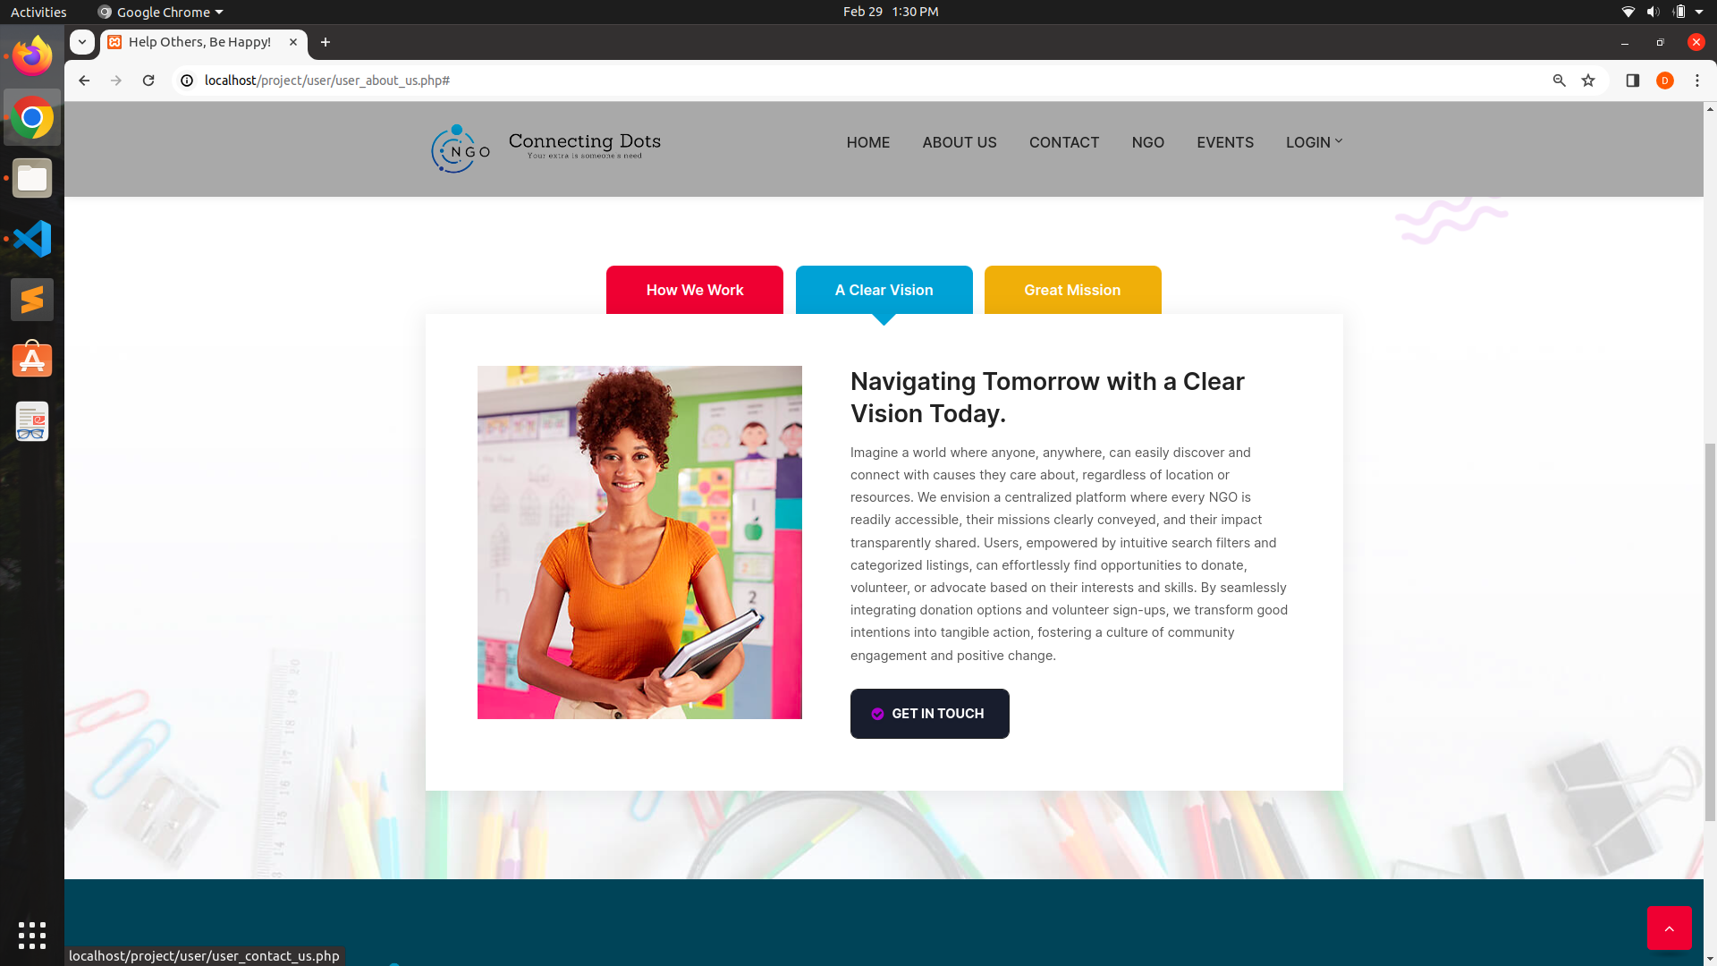
User About Us:

Slide 57
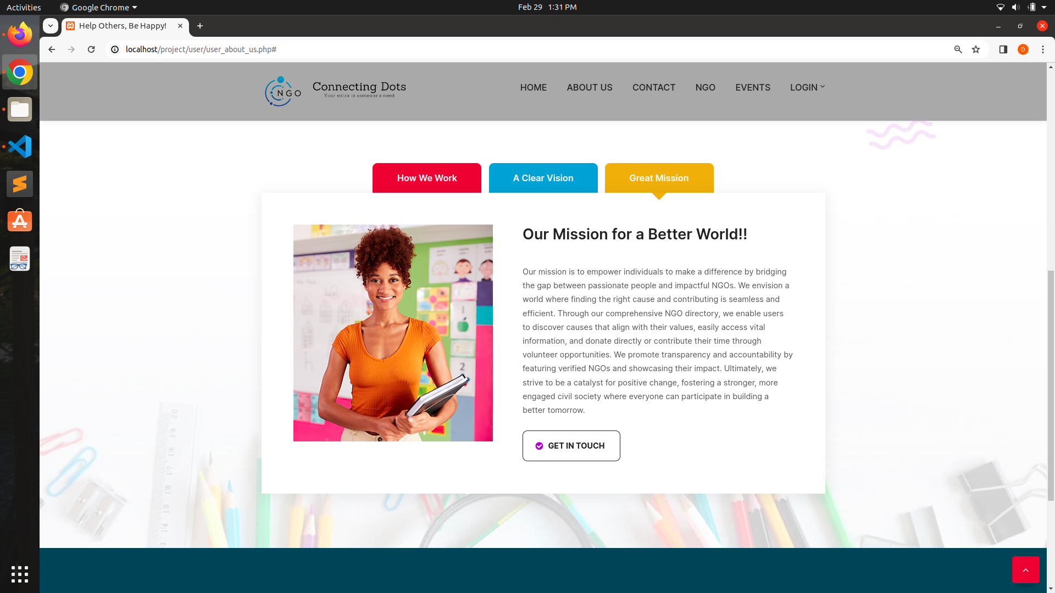
User About Us:

Slide 58
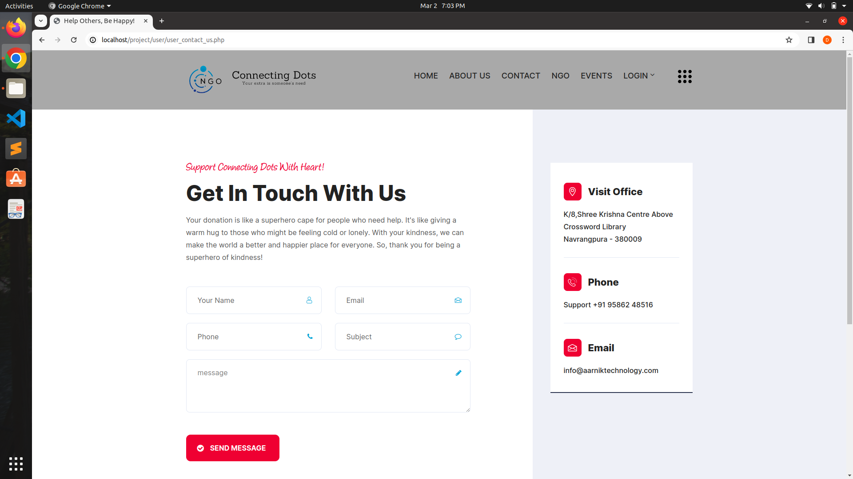
User Contact Us Form:

Slide 59
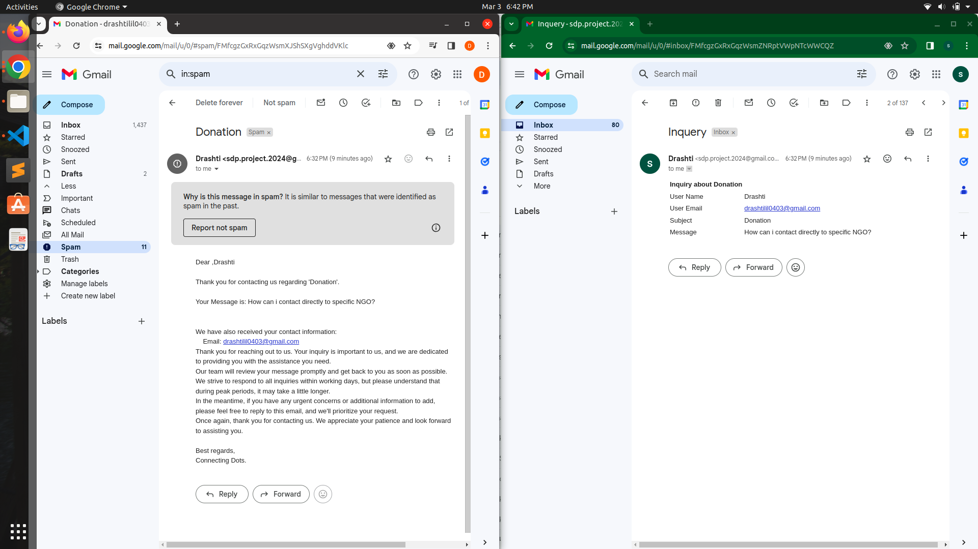

Slide 60
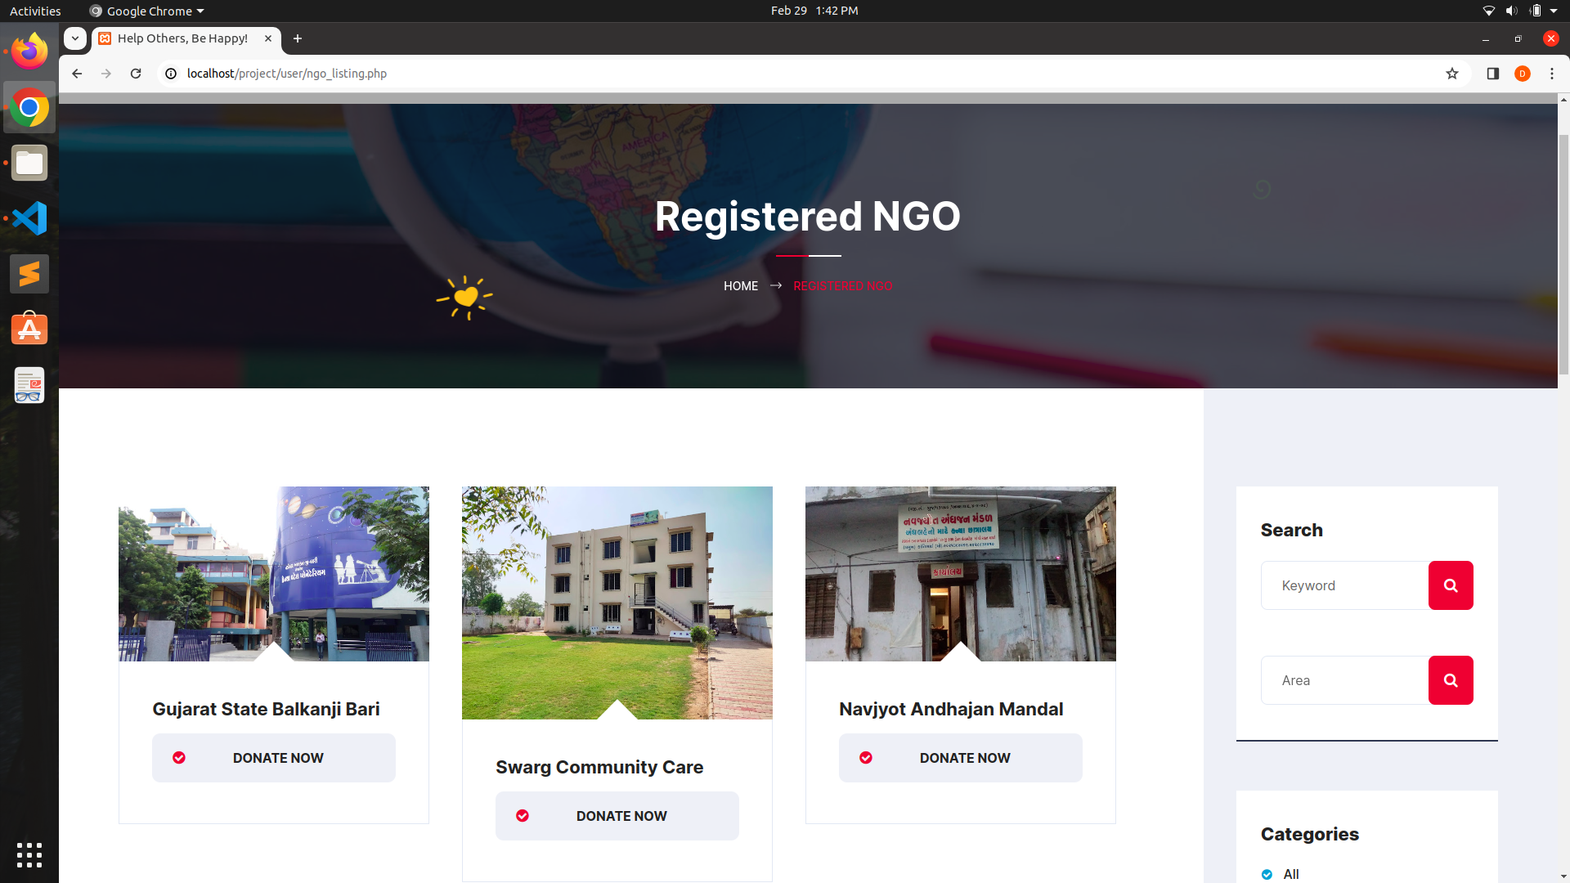
NGO List:

Slide 61
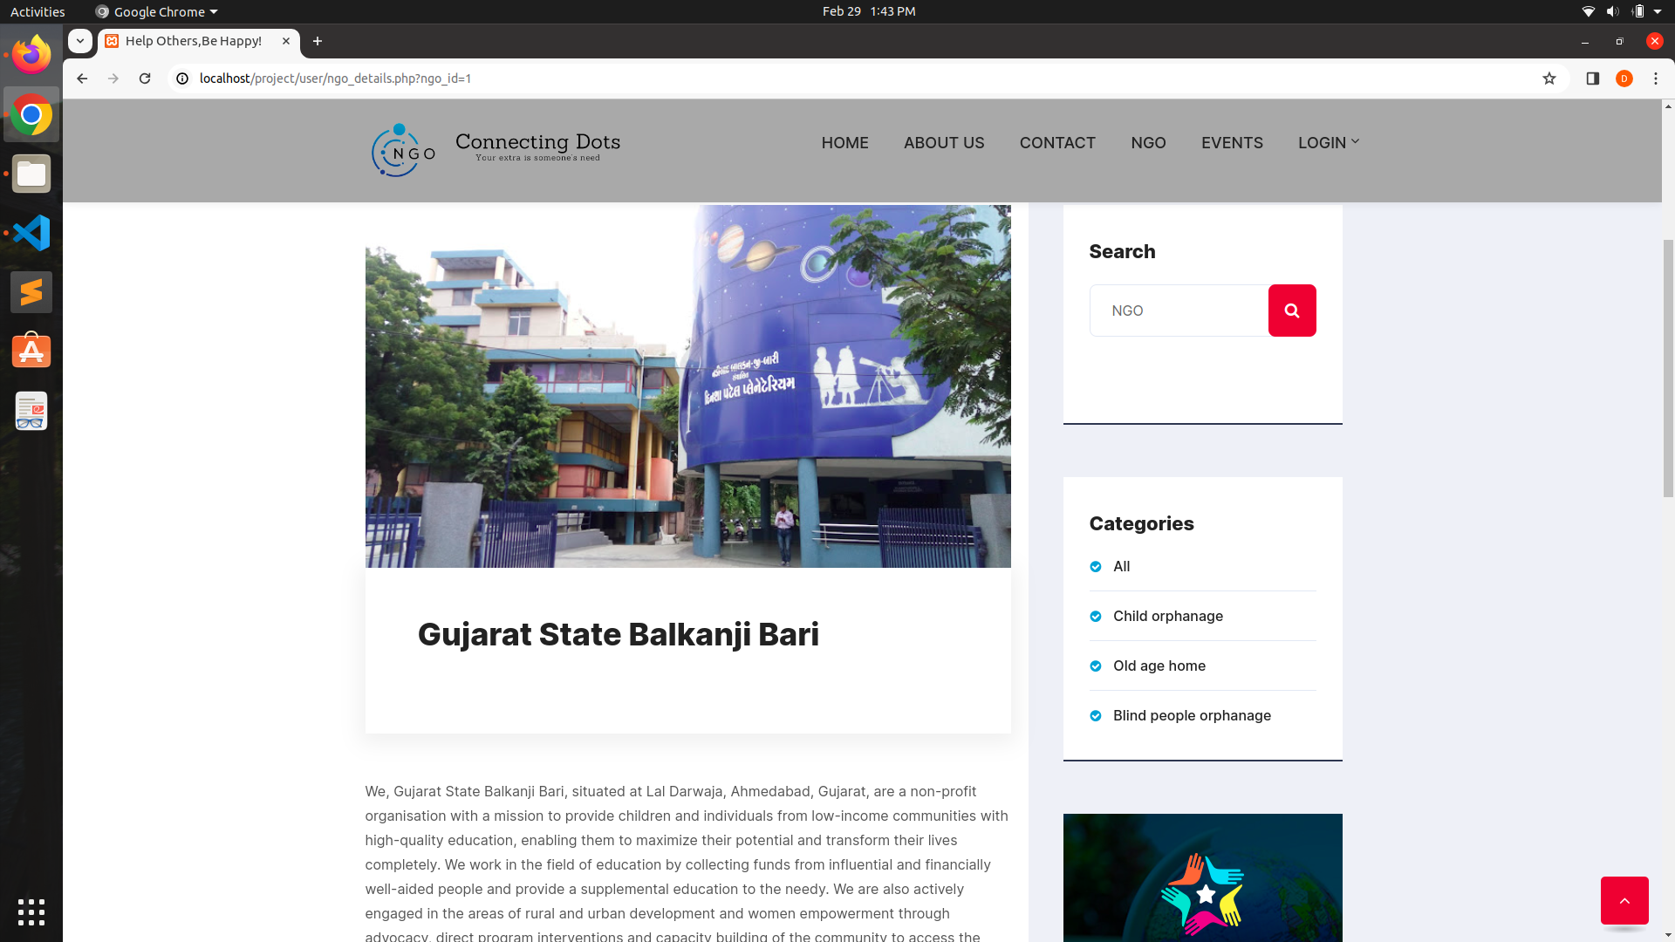
NGO Details:

Slide 62
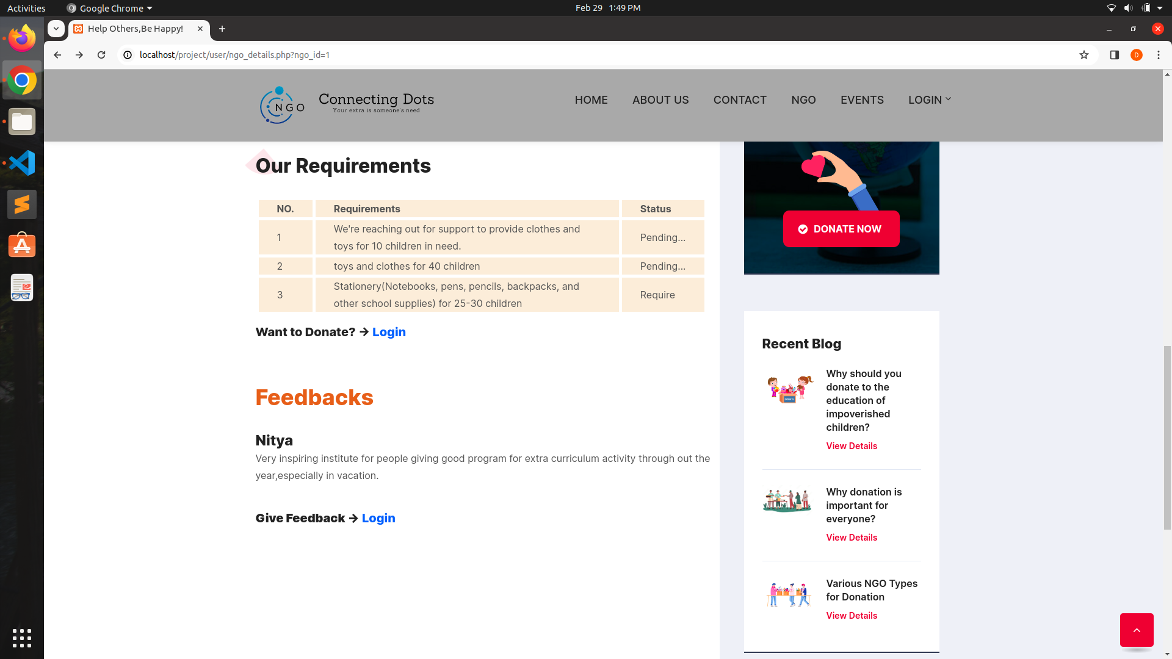
NGO Details:

Slide 63
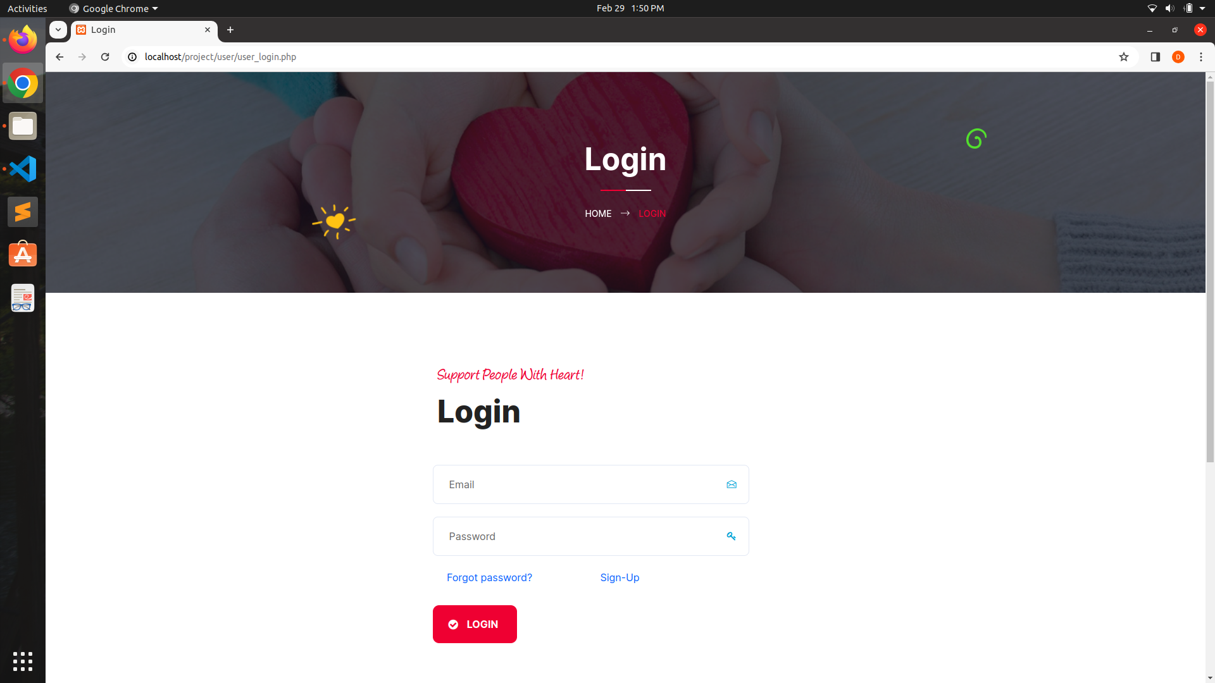
User Login:

Slide 64
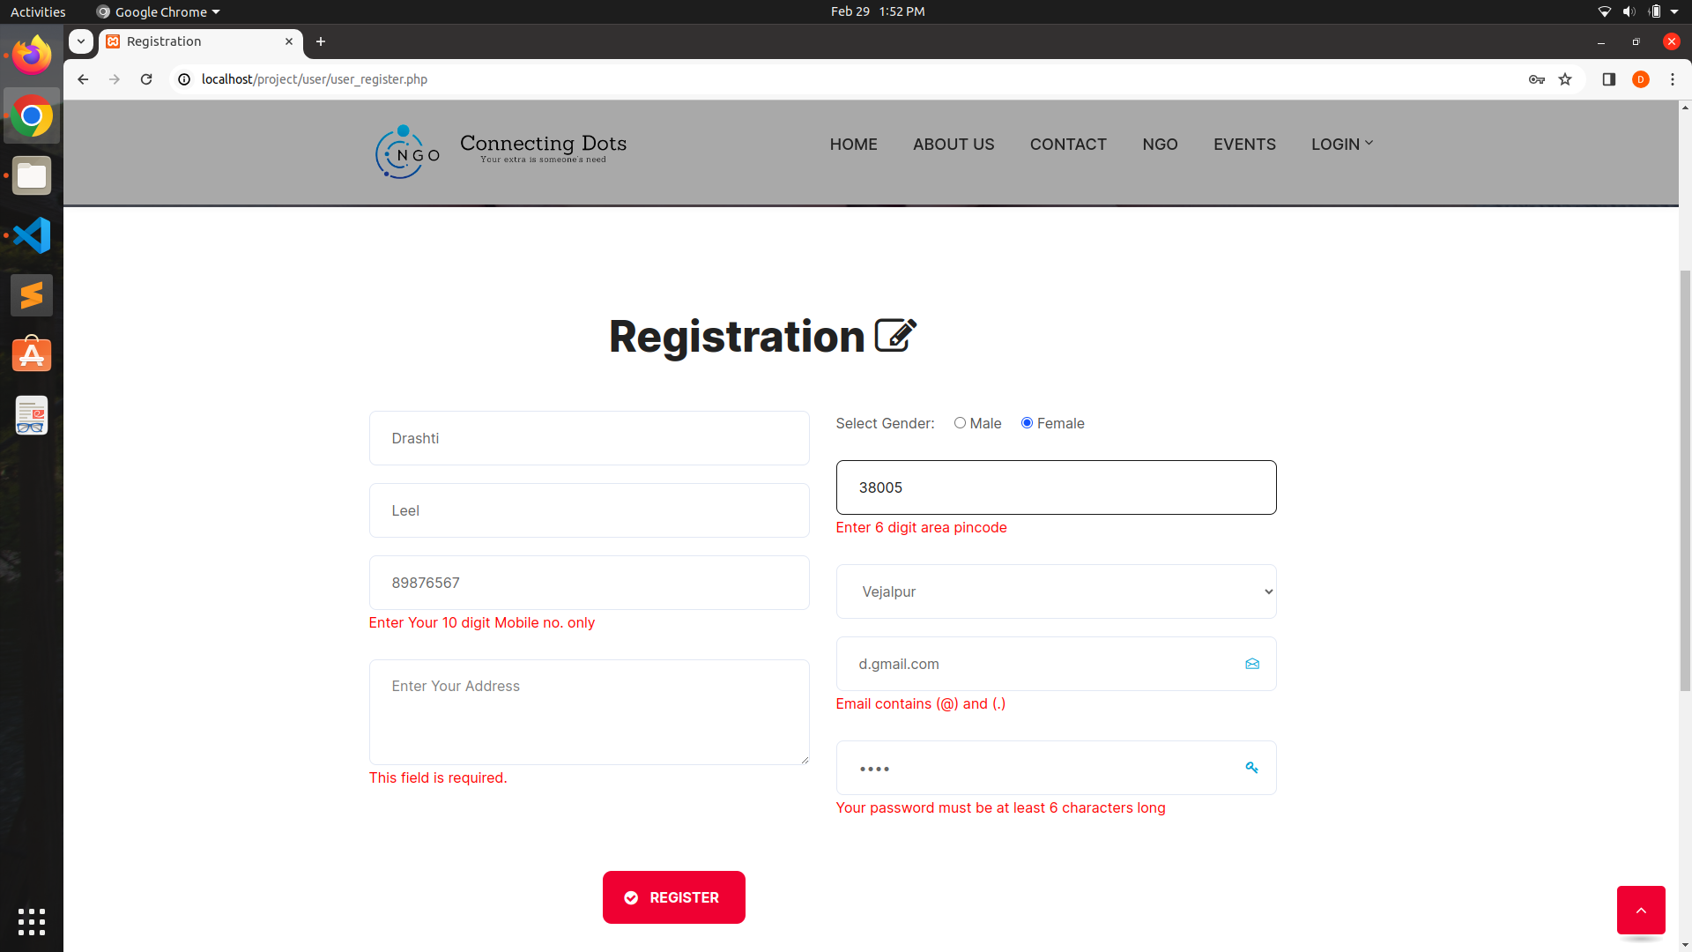
User Registration:

Slide 65
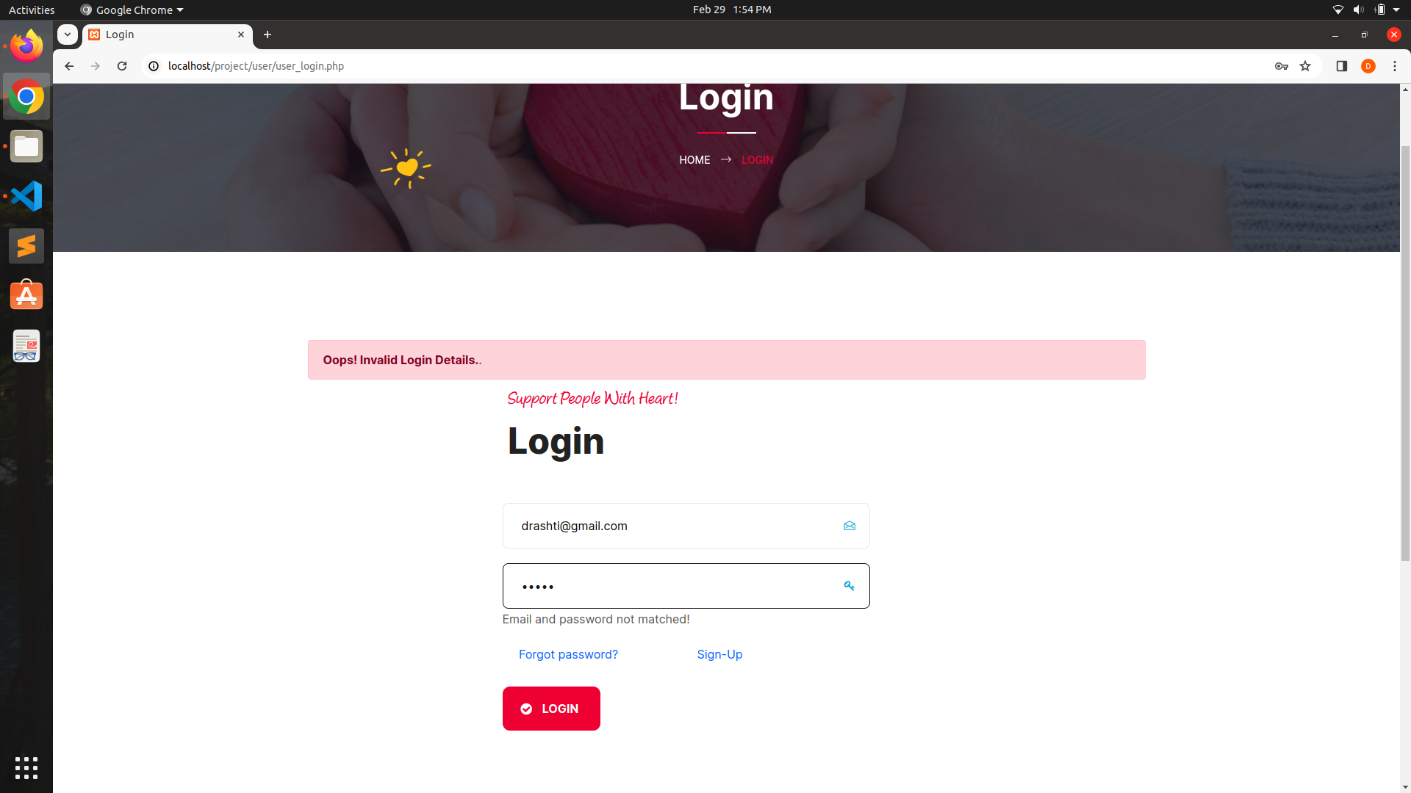
User Invalid Login:

Slide 66
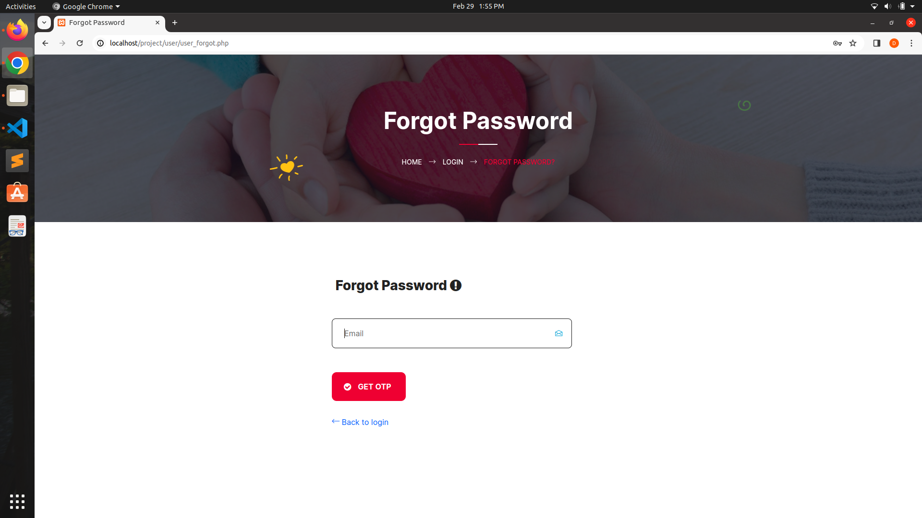
User Forgot Password Form:

Slide 67

OTP sent on email:

Slide 68
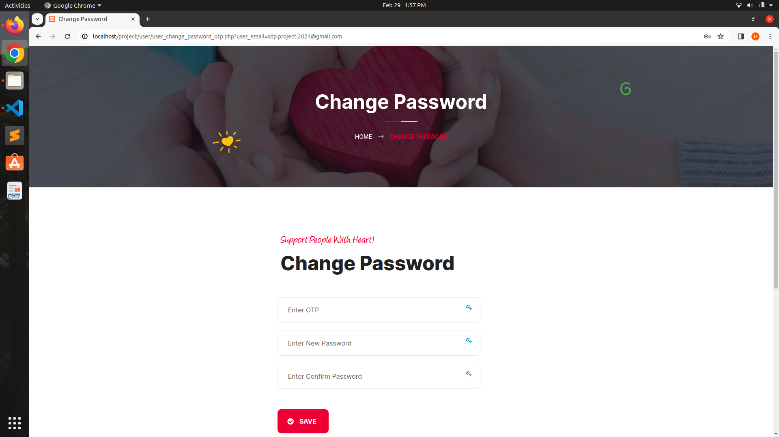
User Change Password Form:

Slide 69

OTP Not Match:

Slide 70

OTP and New Password must be different:

Slide 71

New and Confirm Password not match:

Slide 72

Password Changed:

Slide 73
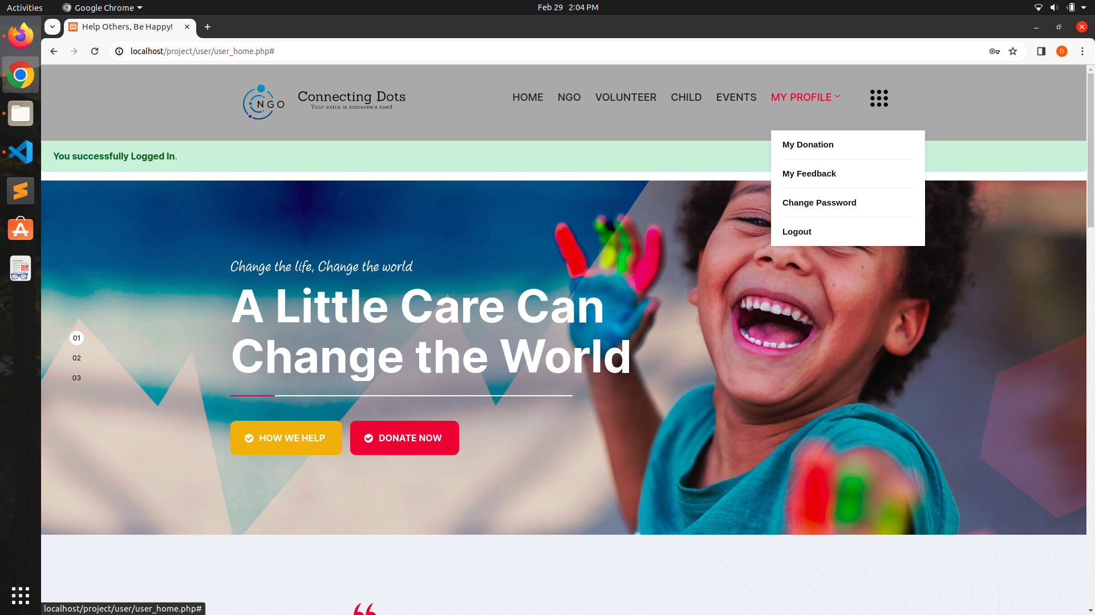
User Home Page After Login:

Slide 74
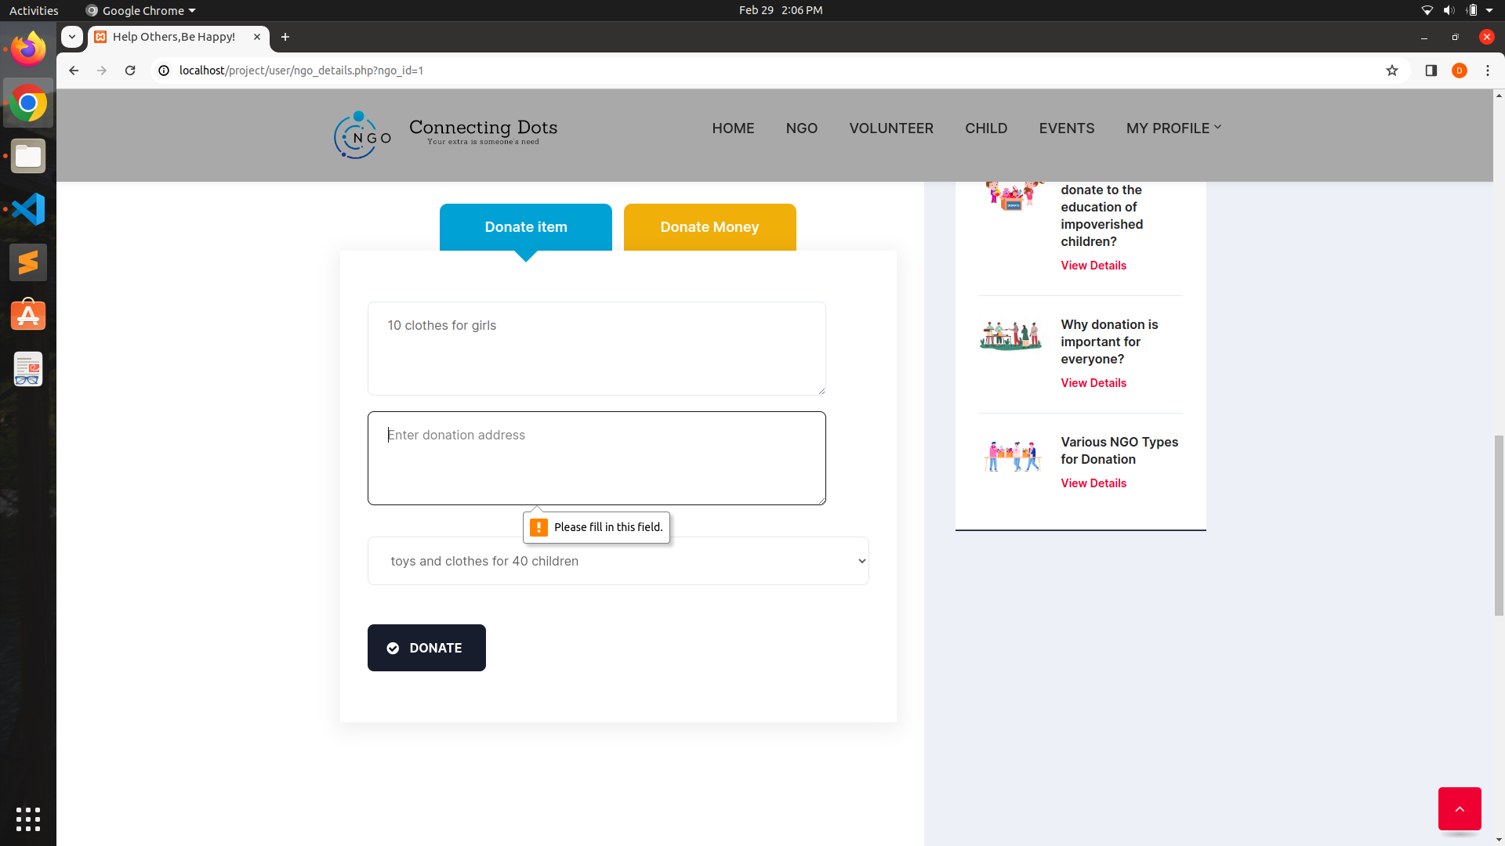
Donate Item:

Slide 75


Slide 76

Donate Money:

Slide 77

Donate Money through UPI Method:

Slide 78

Donate Money through Net Banking:

Slide 79

Donate Money through Debit/Credit Card:

Slide 80

View Donation:

Slide 81

Event List:

Slide 82

Event Details:

Slide 83

Event Details:

Slide 84

Child List:

Slide 85

Child Details:

Slide 86

Volunteer List:

Slide 87

Blog List:

Slide 88

Blog Details:

Slide 89

View Feedback:

Slide 90

FAQ:

Slide 91
07
NGO Panel Screenshots

Slide 92

NGO Register:

Slide 93

NGO Login:

Slide 94

NGO Account not activated:

Slide 95

NGO Invalid Login:

Slide 96

NGO Dashboard:

Slide 97

NGO Details:

Slide 98

NGO Edit Profile:

Slide 99

Item Requirement Form:

Slide 100

Item Requirement Information:

Slide 101

Delete Item Requirement Information:

Slide 102

Item Requirement Information Deleted:

Slide 103

Update Item Requirement Information:

Slide 104

Item Requirement Information Updated:

Slide 105

Donation Information:

Slide 106

Child Information:

Slide 107

Delete Child Information:

Slide 108

Child Information Deleted:

Slide 109

Update Child Information:

Slide 110

Child Information Updated:

Slide 111

Event Form:

Slide 112

Event Information:

Slide 113

Delete Event Information:

Slide 114

Update Event Information:

Slide 115

Event Information Updated:

Slide 116

Volunteer Information:

Slide 117

Feedback Information:

Slide 118

Change Password:

Slide 119
08
Volunteer Panel Screenshots

Slide 120

Volunteer Registration:

Slide 121

Volunteer Login:

Slide 122

Volunteer Account not activated:

Slide 123

Volunteer Home page:

Slide 124

Volunteer Task Page:

Slide 125

Volunteer Update Profile:

Slide 126

Volunteer Profile Updated:

Slide 127

Volunteer Change Password:

Slide 128
09
Conclusion

Slide 129

Conclusion
Thus we conclude that we enjoyed very much working on the project “Connecting Dots” our internal guide Prof. Deep Mavawala helped us a lot in improving the quality of our project.
This is just the Stepping stone for project development there is new paths to be discovered and there are new goals that are to be achieved .

Slide 130
10
Bibliography

Slide 131
Reference Book :-
1. Magnifying Object-Oriented Analysis and Design
Authors : Arpita Gopal and Netra Patil
Publisher : PHI Learning
Internet :-
https://www.google.com/
https://www.w3schools.com/

Slide 132



Thanks

